Slide 1
AWAS
And Employability?

Slide 2
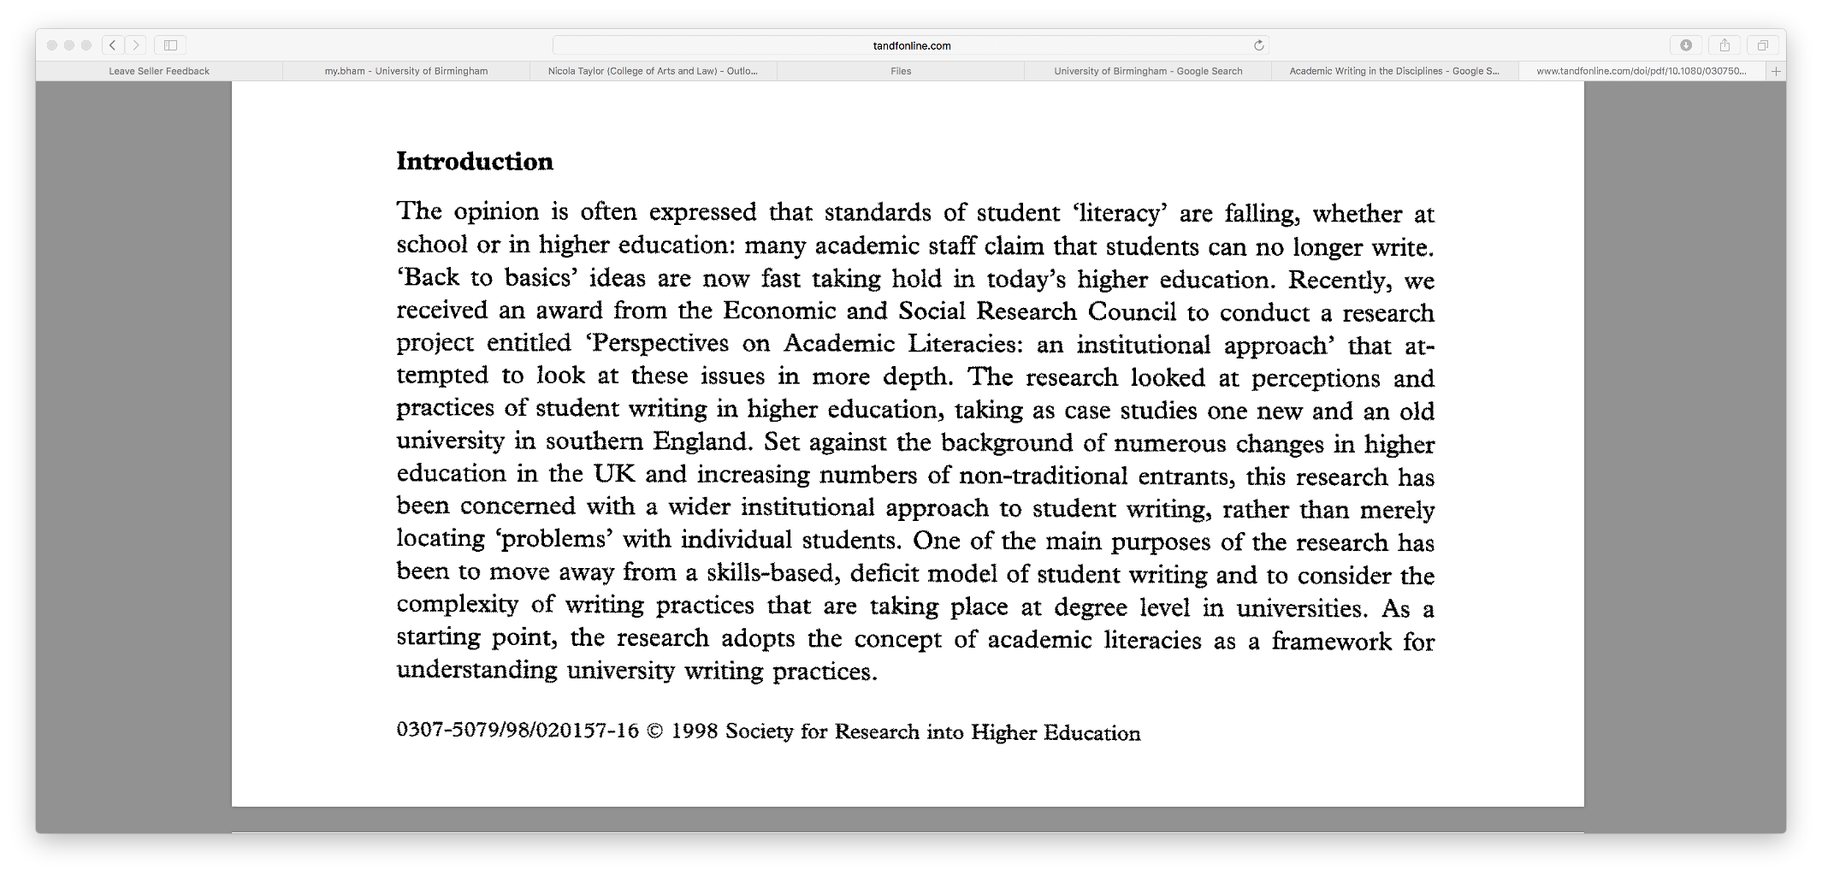
ACADEMIC WRITING
Is…
Clear
Concise
Coherent
Confident
creative
Convincing!

Slide 3
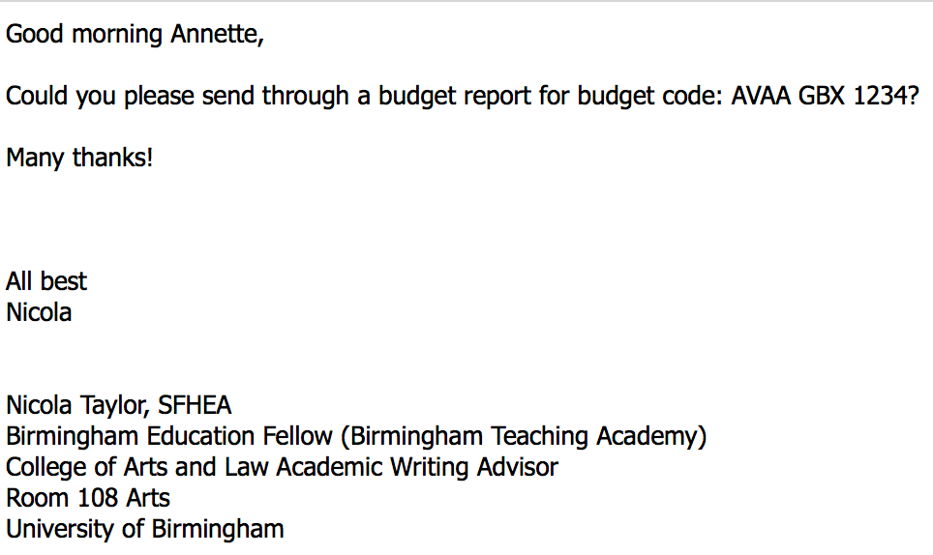
AWAS and e-mails
audience, purpose and tone?
Be concise
Be clear
Be courteous
Application:
giving / seeking information
requesting action

Slide 4
AWAS and Blogs
audience, purpose and tone?
Be clear
Be confident
Be creative
https://www.timeshighereducation.com/blog/seven-reasons-why-blogging-can-make-you-better-academic-writer

Slide 5
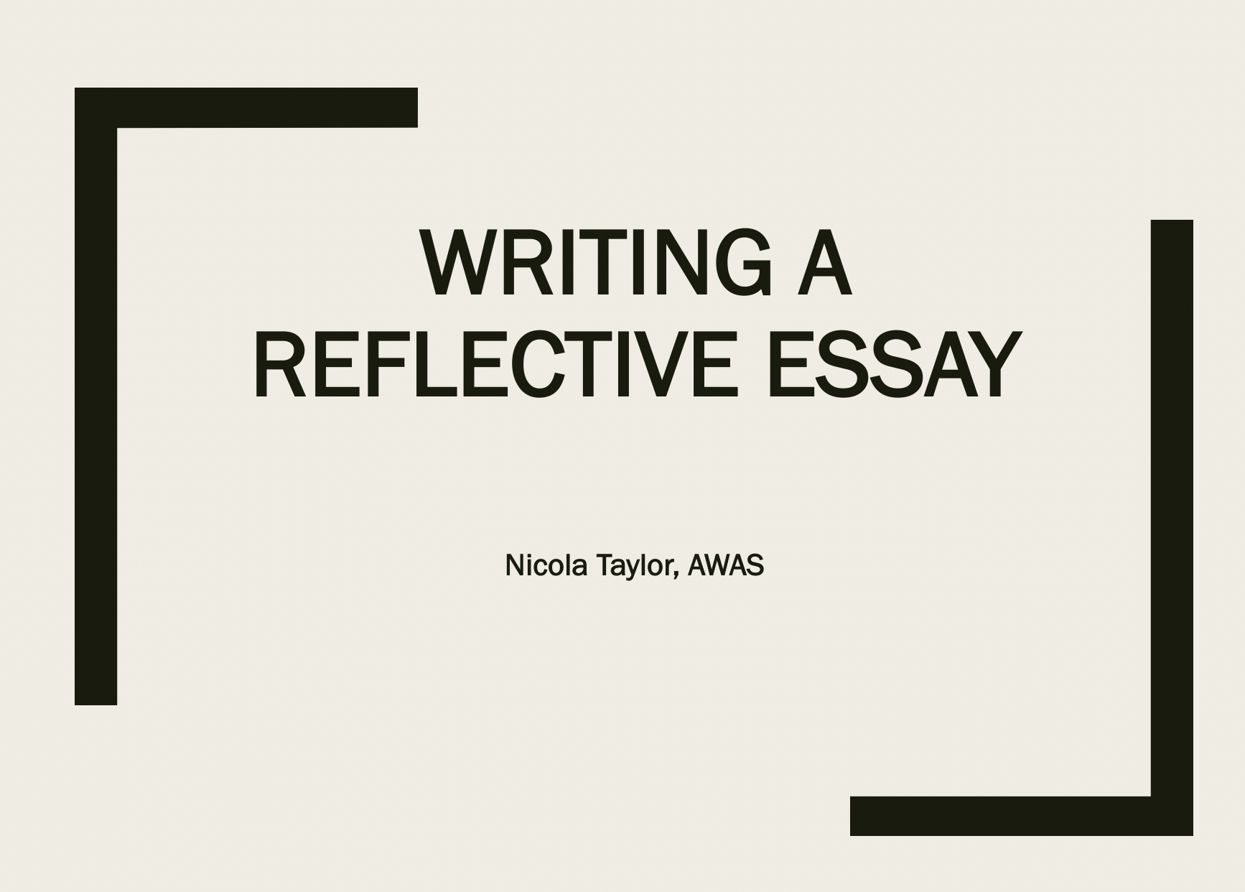
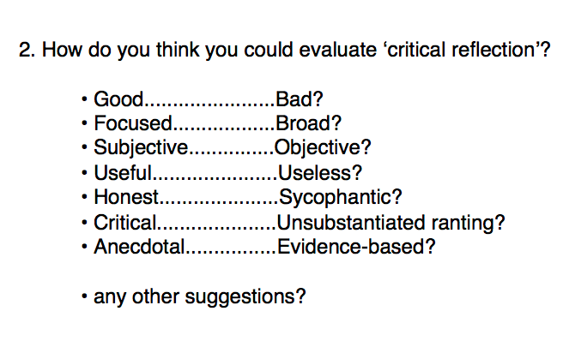
Awas and reflective writing
audience, purpose and tone?
Be honest
Make connections
Seek clarity through reflection

Slide 6
Awas and reports
audience, purpose and tone?
Be clear
Be concise
Be systematic
Be confident
Be convincing

Slide 7
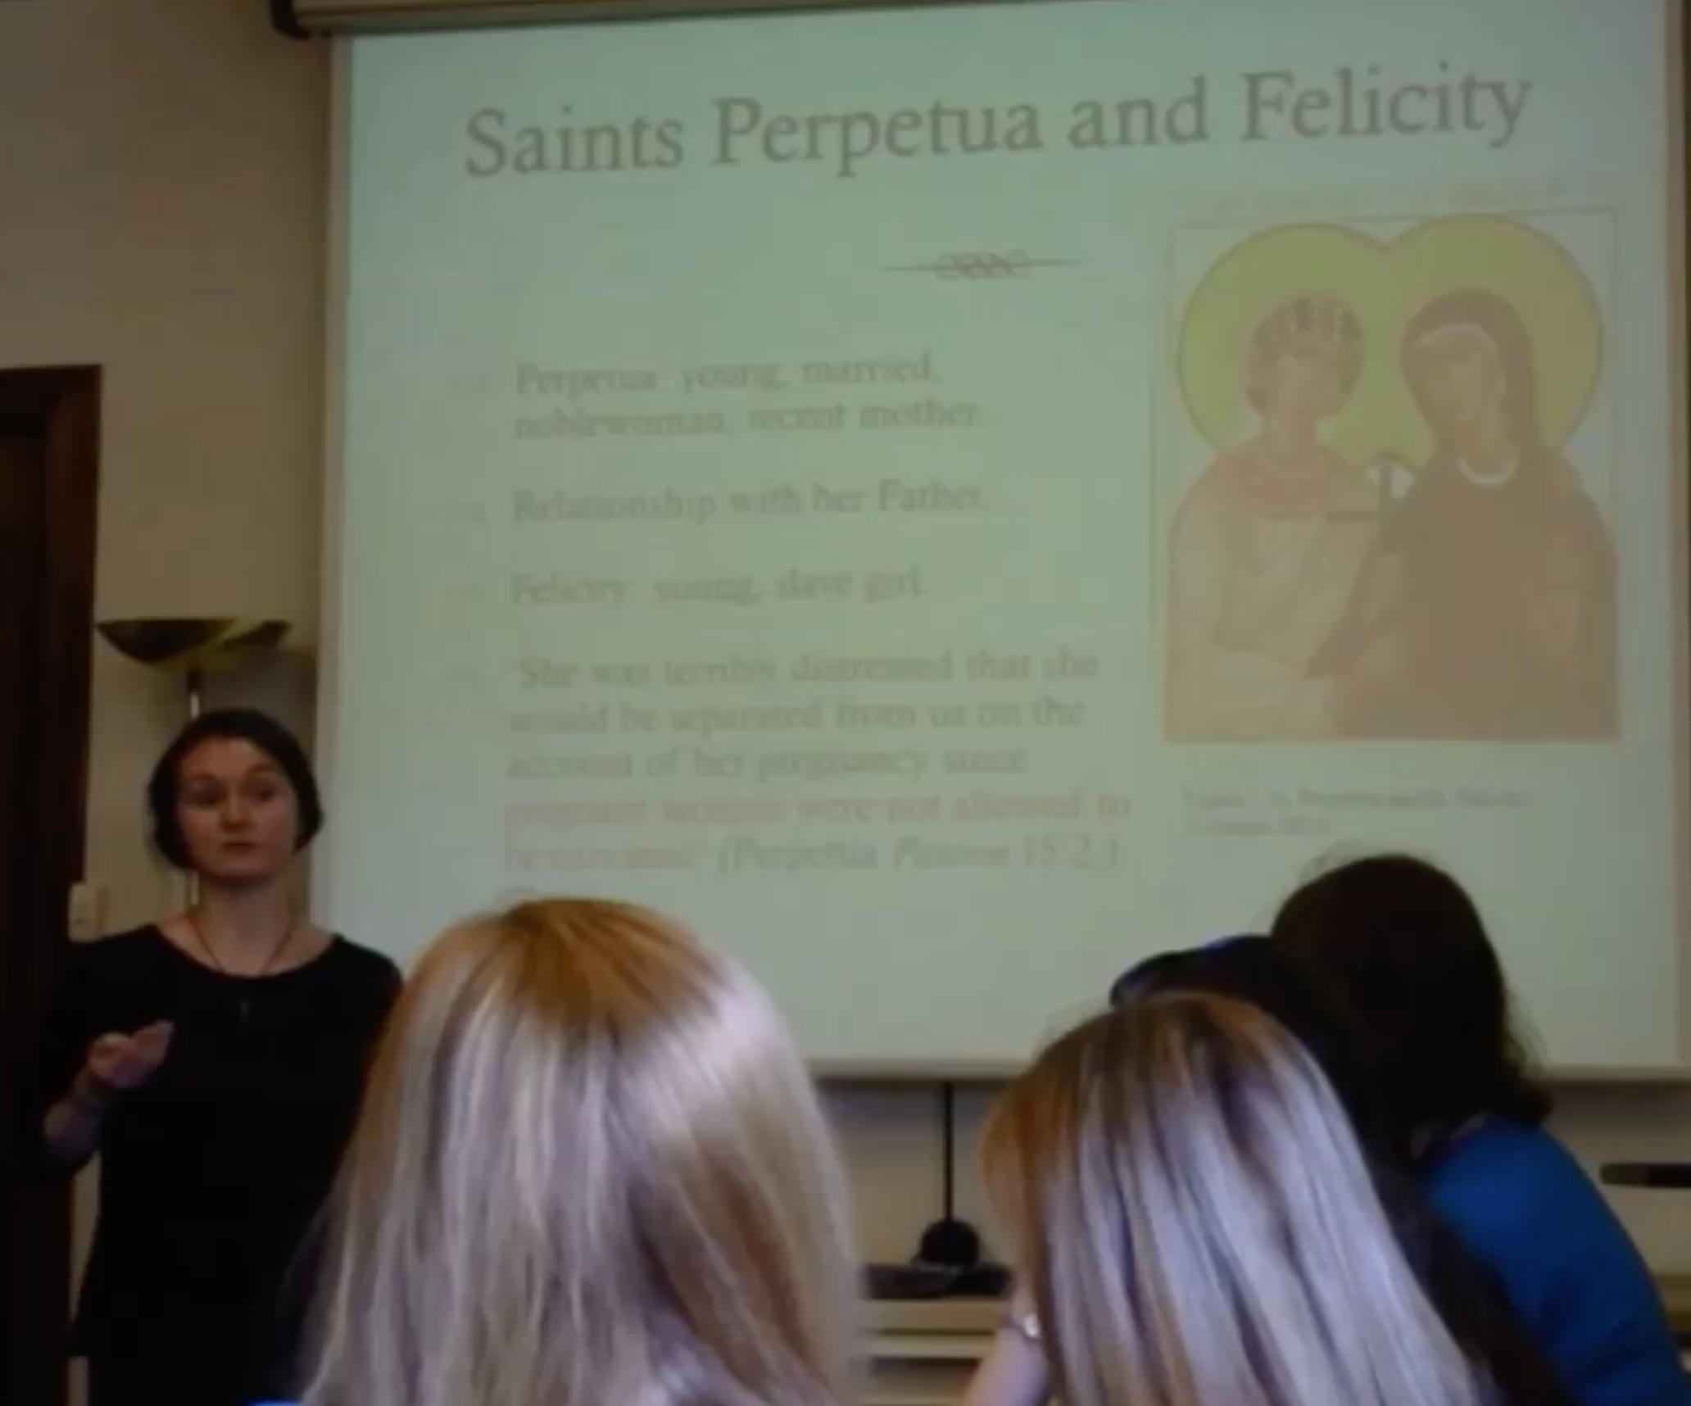
Awas and presentations
audience, purpose and tone?
Be clear
Be concise
Be coherent
Be confident
Be convincing
canvas.bham.ac.uk/courses/10505/pages/oral-presentations

