Slide 1
Meeting the future now, challenges and opportunities The evolution U21 Library Conference September 2018

Slide 2
This presentation will cover
Space and library buildings
Collections and collecting
Technology
Staff

Slide 3
Space and library buildings

Slide 4
Libraries as emblems of culture
“Libraries can be much more that simply places to store books. Throughout the ages, the designs of the greatest library buildings have celebrated the act of reading and the importance of learning. They have become emblems of culture, whether it be for an individual, an institution, or even a whole nation.”
(Campbell, J. W. P, and Pryce, W., 2013, p. 19)

Slide 5
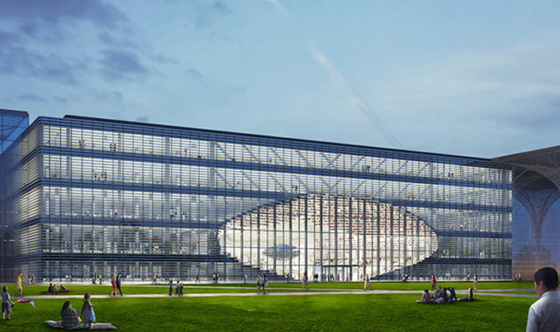
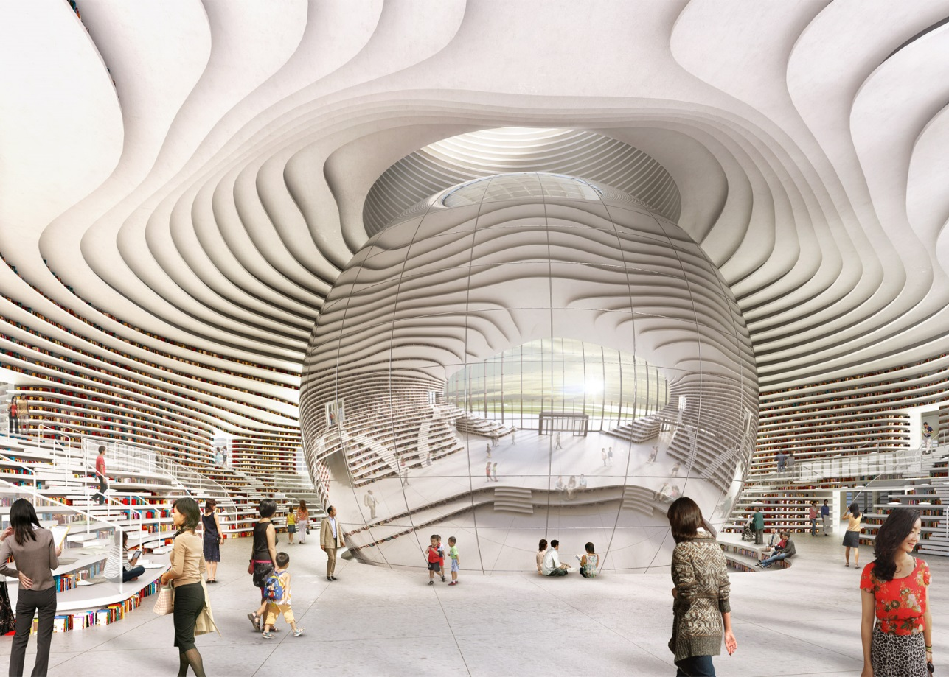
Tianjin Binhai Library (The Eye), Tianjin, China
http://inspiringgoodliving.com/thianjin-binhai-library-eye-looks-within/
https://www.dezeen.com/2016/06/23/tianjin-binhai-library-mvrdv-china-eye-shaped-nears-completion/

Slide 6
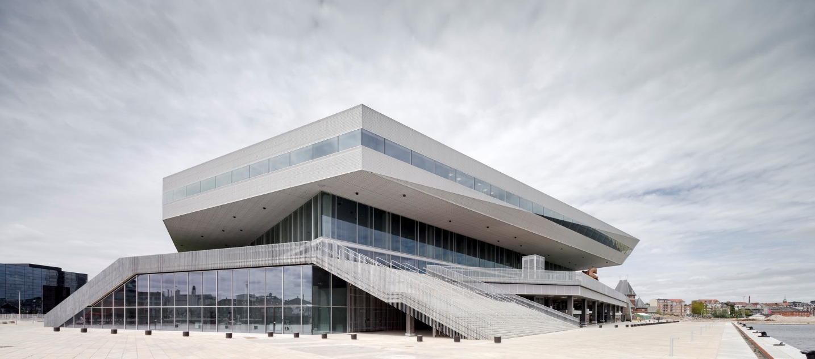
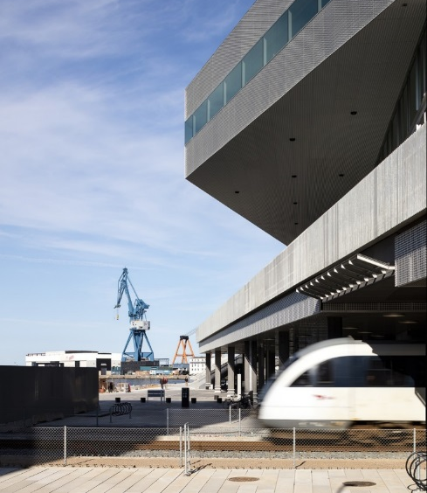
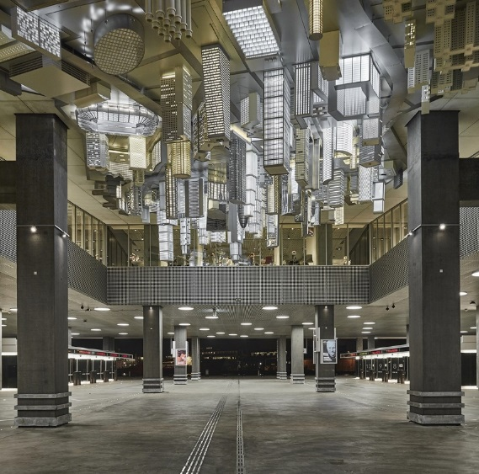
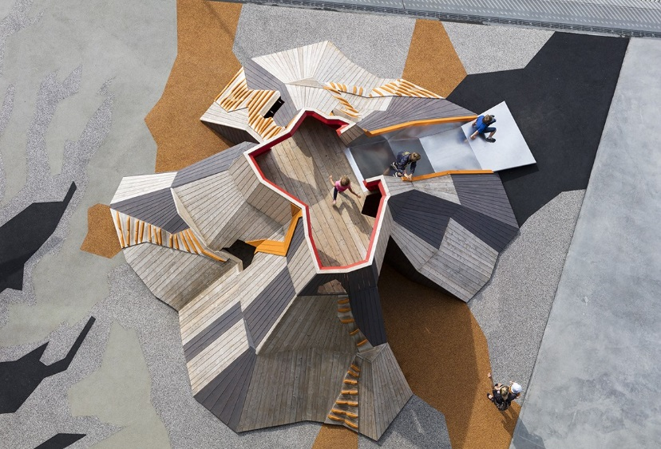
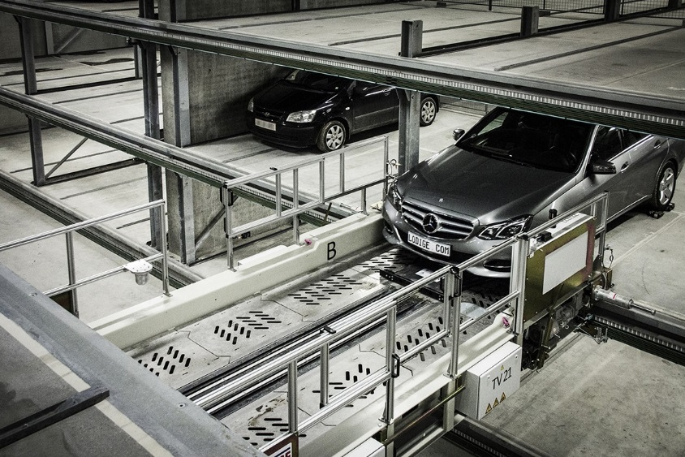
Dokk1, Aarhus, Denmark
https://www.archdaily.com/644920/dokk1-schmidt-hammer-lassen-architects
A station on the Light Rail Transit system
Culture meets art
Playground
Fully automated car park
http://www.shl.dk/dokk1/
http://www.shl.dk/dokk1/
http://www.shl.dk/dokk1/
http://www.shl.dk/dokk1/

Slide 7
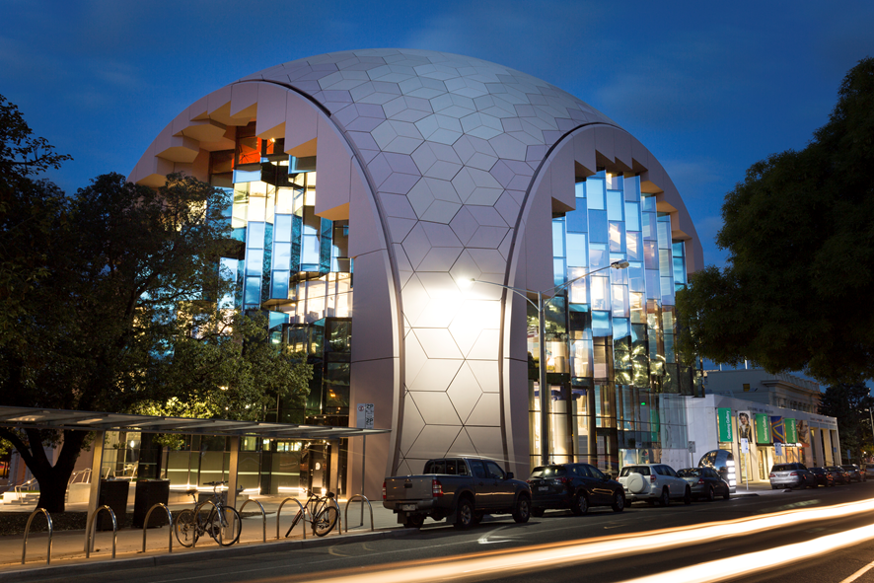
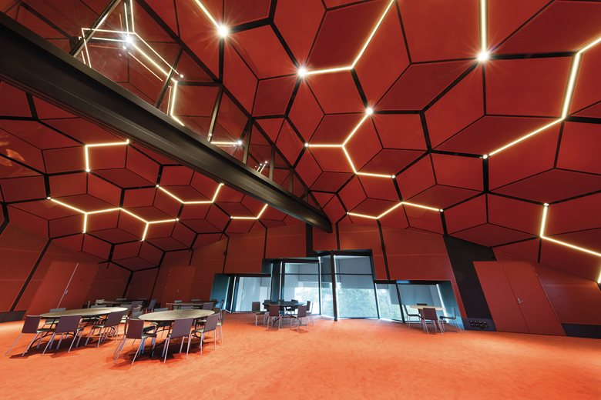
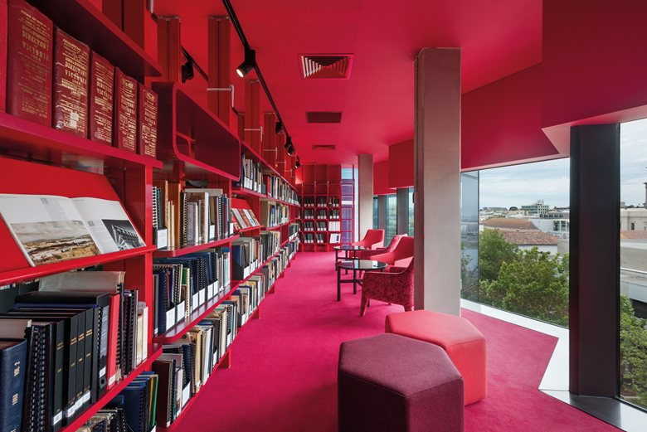
Geelong Library and Heritage Centre, Geelong, Australia
http://www.grlc.vic.gov.au/glhc
https://www.archilovers.com/projects/202278/geelong-library-and-heritage-centre.html
https://www.archilovers.com/projects/202278/geelong-library-and-heritage-centre.html

Slide 8
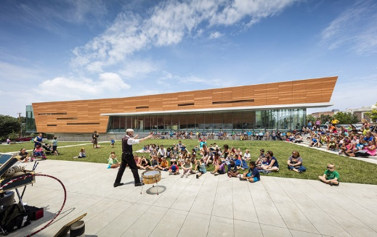
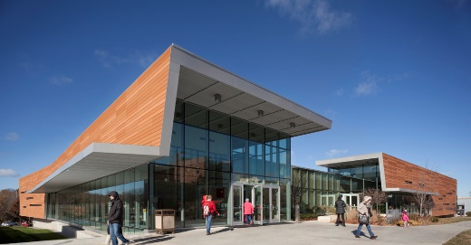
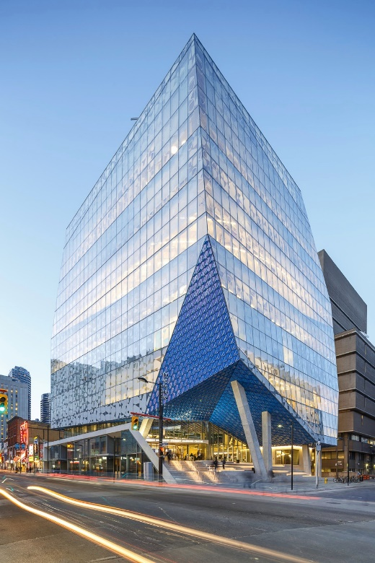
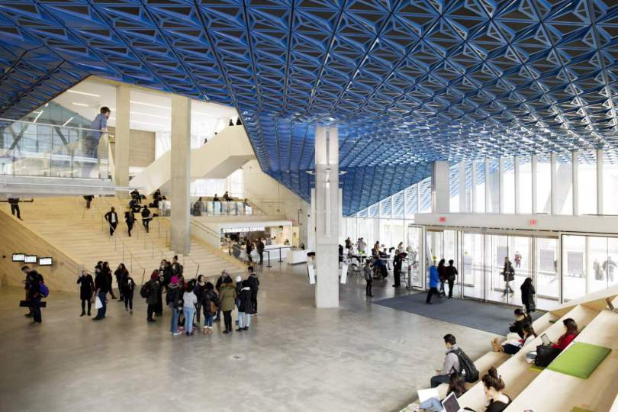
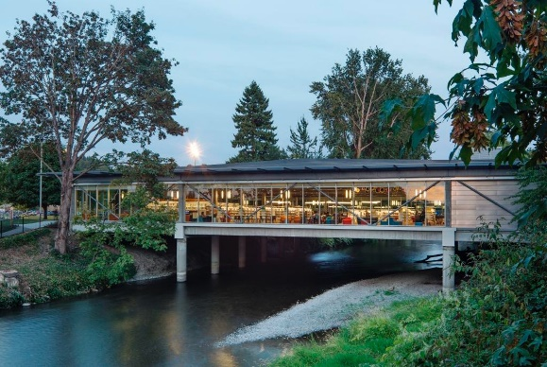
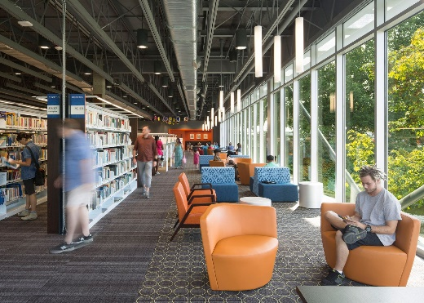
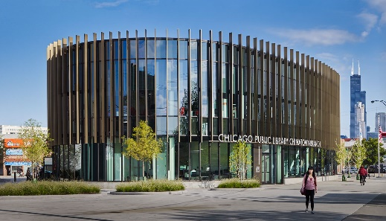
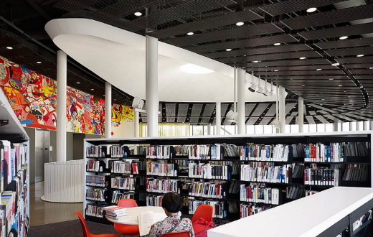
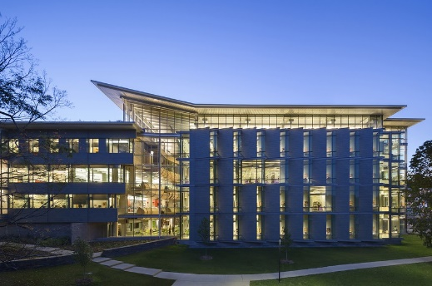
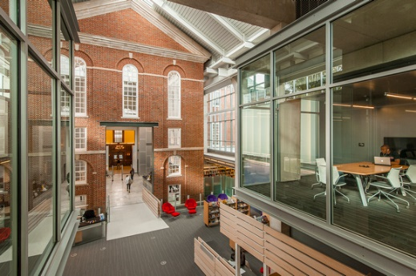
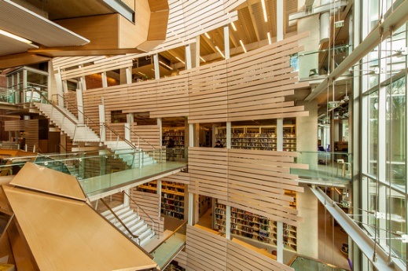
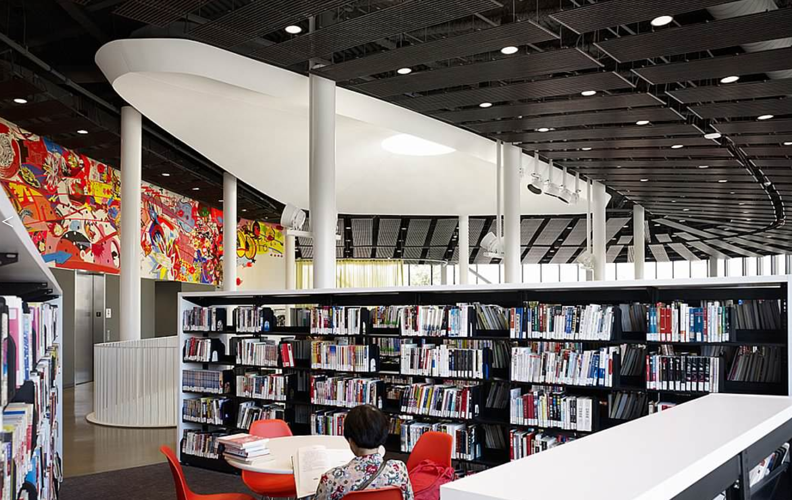
Library | Image | Image | Image
Lawrence Public Library, Kansas, USA | https://www.archdaily.com/784930/lawrence-public-library-gould-evans | http://www.spillers.com/lawrence-public-library-1/
Ryerson University Student Learning Centre (SLC), Toronto, Canada | https://www.archdaily.com/771491/ryerson-university-student-learning-centre-zeidler-partnership-architects-plus-snohetta | http://aasarchitecture.com/2015/12/ryerson-university-student-learning-centre-in-toronto-by-snohetta.html/ryerson-university-student-learning-centre-in-toronto-by-snohetta-07
Renton Library, Washington, USA | https://architizer.com/projects/renton-public-library-1/media/1521323/ | https://architizer.com/projects/renton-public-library-1/media/1521328/
Chinatown Branch, Chicago Public Library, Chicago, USA | https://www.som.com/projects/chicago_public_library_chinatown_branch | https://www.som.com/projects/chicago_public_library_chinatown_branch
Sawyer Library, Massachusetts, USA | 8 https://www.architectmagazine.com/project-gallery/sawyer-library_o | https://www.robertumenhofer.com/architectural/h1A4D90B3#h1a4d90b3 | https://www.robertumenhofer.com/architectural/hEFF4898#heff4898

Slide 9
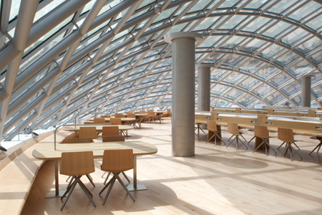
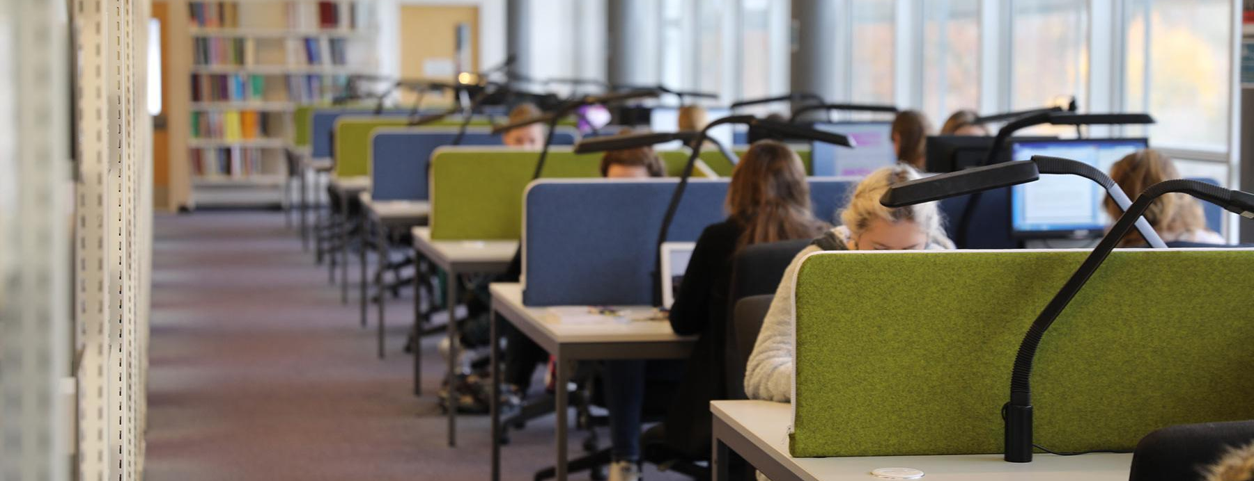
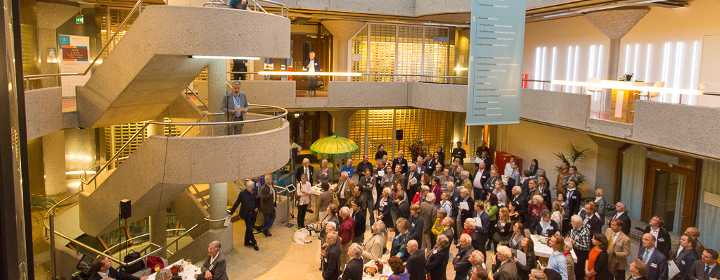
The four paradigms
Reader-centred
Book-centred
Learning-centred
Social responsibility

Slide 10
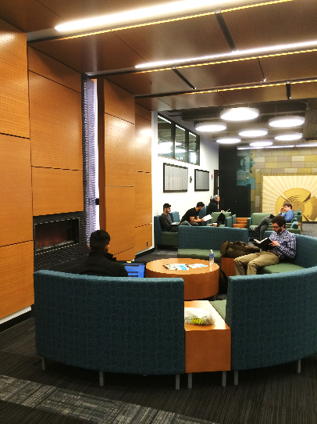
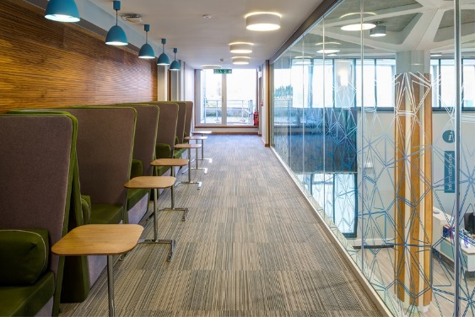
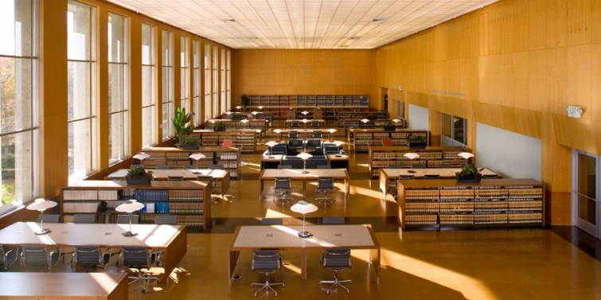
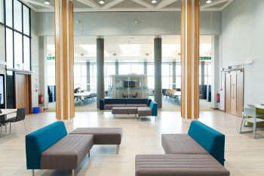
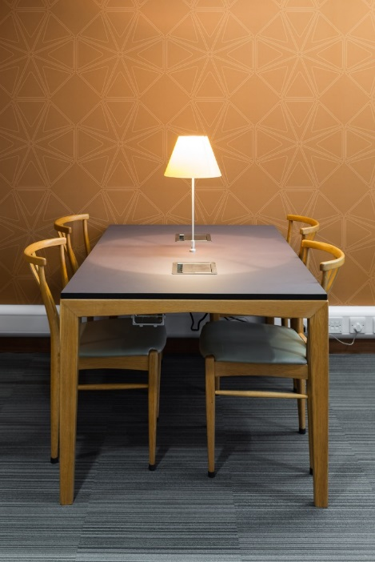
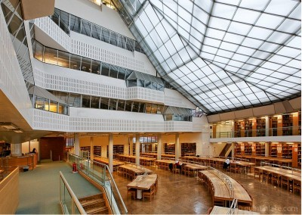
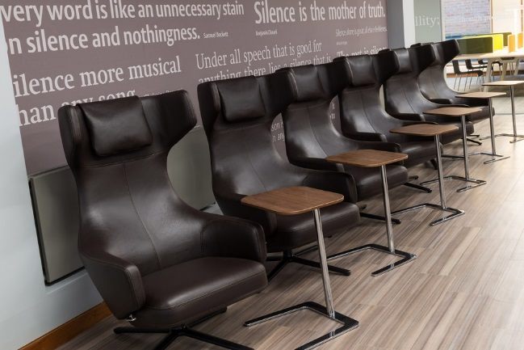
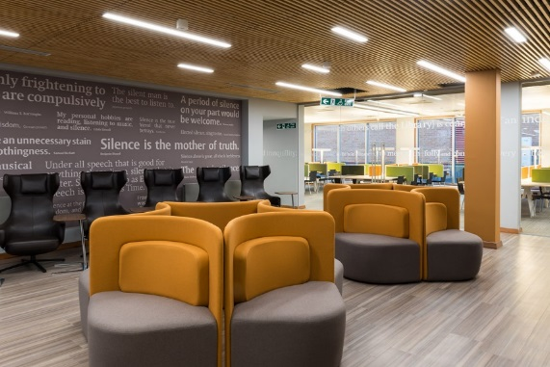
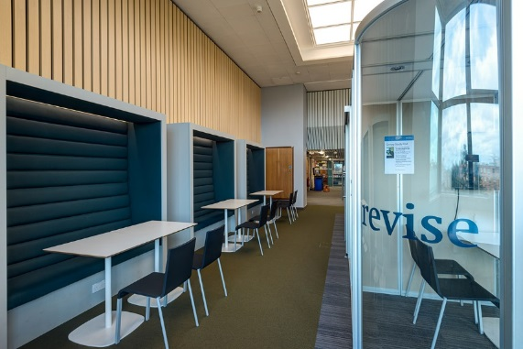
The four paradigms
Reader-centred
https://copac.jisc.ac.uk/about/libraries/reading.html
http://news.lib.uchicago.edu/blog/2011/05/09/mansueto-library-reading-room-to-open-may-16/
http://www.criticaldigital.co.uk/2015/03/22/reading-university-library/
http://www.moorerubleyudell.com/project-image/main-reading-room-boalt-hall-library-university-california-berkeley-3
http://www.baileyedward.com/portfolio/16
https://www.hist.cam.ac.uk/seeley-library/images/library-internal-1/view
http://www.criticaldigital.co.uk/2015/03/22/reading-university-library/
http://www.criticaldigital.co.uk/2015/03/22/reading-university-library/
http://www.criticaldigital.co.uk/2015/03/22/reading-university-library/
http://www.criticaldigital.co.uk/2015/03/22/reading-university-library/

Slide 11
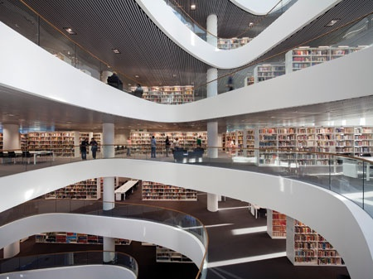
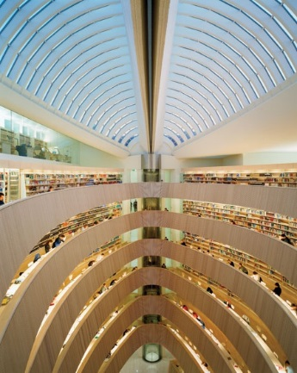
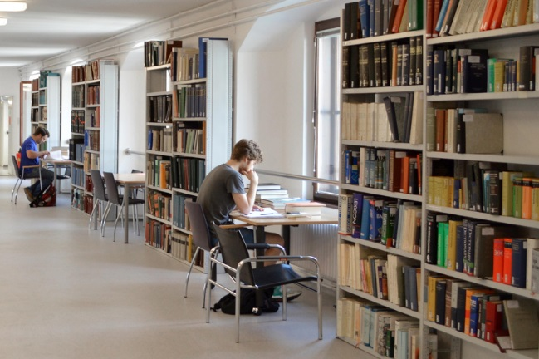
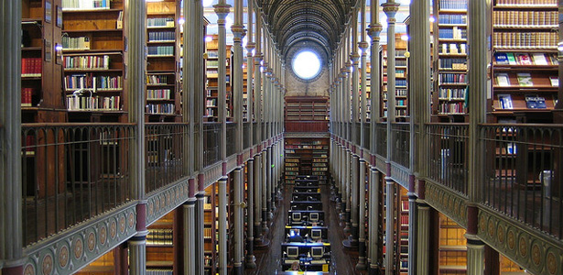
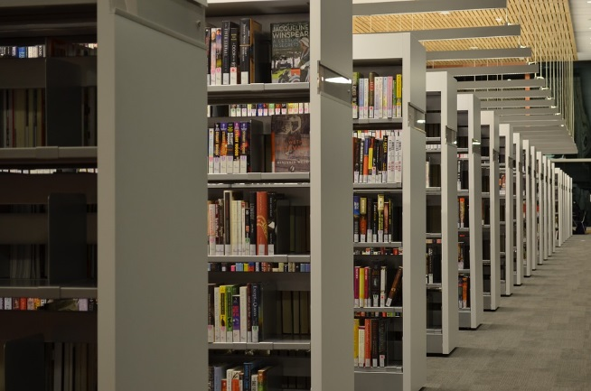
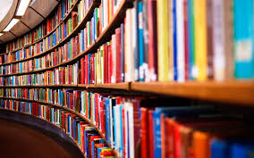
The four paradigms
Book-centred
https://www.timeshighereducation.com/five-of-the-most-striking-university-libraries-you-will-ever-see/2012248.article
https://www.timeshighereducation.com/five-of-the-most-striking-university-libraries-you-will-ever-see/2012248.article
https://bibliothek.univie.ac.at/fb-byzantinistik/en/
https://www.nottingham.ac.uk/library/more-books/more-books.aspx
http://www.methodandmeaning.com/news/2015/2/12/five-first-reads-for-studying-street-children
https://www.theatlantic.com/technology/archive/2011/09/the-fight-over-the-future-of-digital-books/245577/
https://pixabay.com/en/cornell-university-library-shelves-82344/

Slide 12
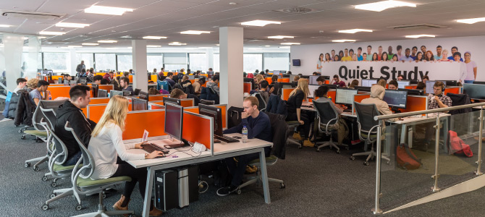
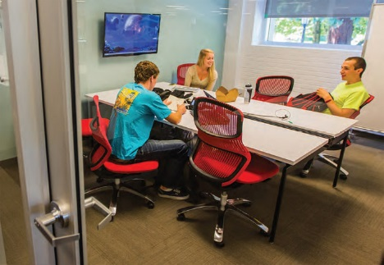
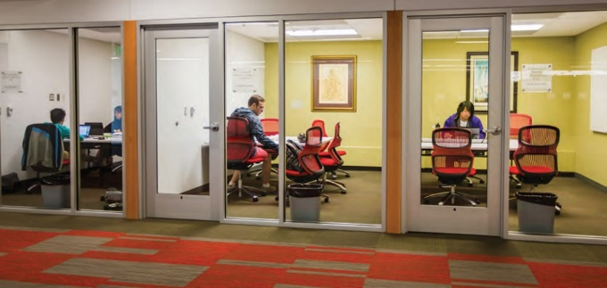
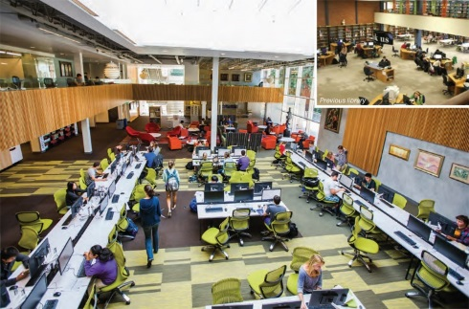
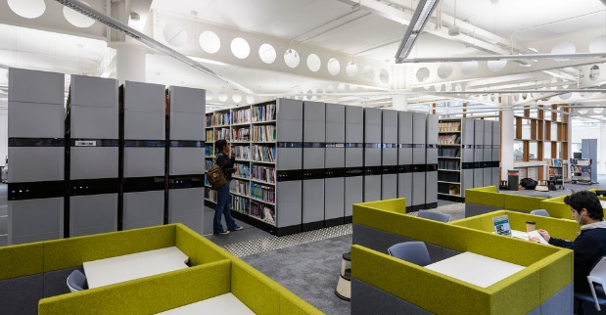
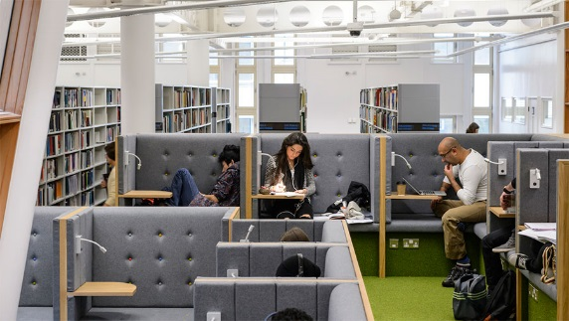
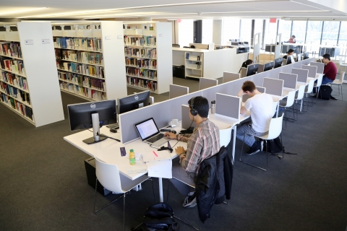
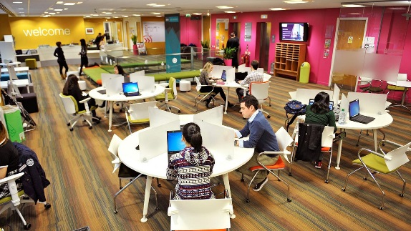
The four paradigms
Learning-centred
https://www.winchester.ac.uk/about-us/venue-hire-and-facilities/library/
https://libguides.bc.edu/oneill/study-spaces
http://www.lboro.ac.uk/services/library/students/usingthelibrary/studyspaces-roombookings/
https://www.knoll.com/knollnewsdetail/university-of-portland-clark-library-inspiration
https://www.knoll.com/knollnewsdetail/university-of-portland-clark-library-inspiration
https://www.knoll.com/knollnewsdetail/university-of-portland-clark-library-inspiration
https://bruynzeel-storage.com/what-universities-can-teach-us-about-academic-library-design/
https://bruynzeel-storage.com/what-universities-can-teach-us-about-academic-library-design/
https://onesearch.library.utoronto.ca/library-info/BUSINESS
https://www.intostudy.com/images/ImagesUni/Newcastle%20University%20London/Learning%20facilities/NUL-students-using-facilities-hero.jpg?w=1255

Slide 13
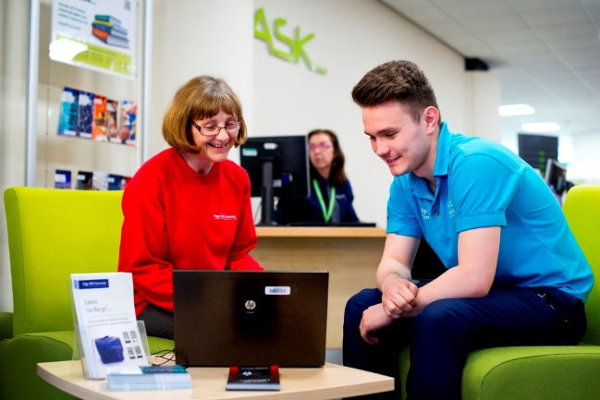
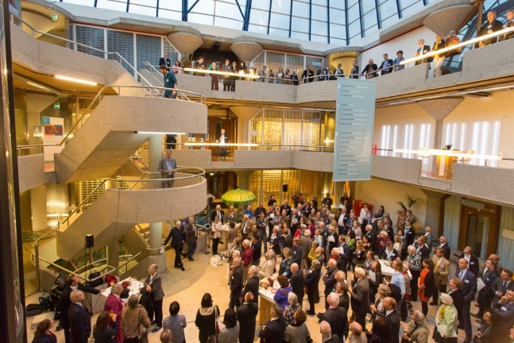
The four paradigms
Social responsibility
https://www.edgehill.ac.uk/study/student-experience/support/
https://www.st-andrews.ac.uk/study/support/student/
http://asianlibraryleiden.nl/?p=18
https://www.tripadvisor.co.uk/LocationPhotoDirectLink-g190454-d5976697-i115484430-Library_Cafe_WU_Wien-Vienna.html

Slide 14
Collections and collecting

Slide 15
Information explosion, from print to electronic, data deluge
“publication has been extended far beyond our present ability to make real use of the record” (Bush, 1945)
“data and information always have been both the input and output of research. What is new is the scale of the data and information involved”. (Borgman, 2007)
“There are 2.5 quintillion bytes of data created each day at our current pace, but that pace is only accelerating with the growth of the Internet of Things (IoT). Over the last two years alone 90 percent of the data in the world was generated.” (Marr, 2018)

Slide 16
The scholarly communications environment
“the system through which research and other scholarly writings are created, evaluated for quality, disseminated to the scholarly community, and preserved for future use. The system includes both formal means of communication, such as publication in peer-reviewed journals, and informal channels, such as electronic listservs”
(Association of Research Libraries, 2016).

Slide 17
Technology

Slide 18
2. The digital student
The digital student

Slide 19
What does this mean for libraries

Slide 21
Library staff

Slide 22
Librarian as ….
teacher;
technology specialist;
embedded librarian;
information consultant;
knowledge manager;
and subject librarian.
Vassilakaki and Moniarou-Papaconstantinou (2015)
educator and facilitator of communities
(Bennett, 2009, Thompson, 1974, Brabazon, 2014, Corrall, 2010)
collector and protector of information
(Gray, 2012, Bennett, 2009)
technology leader and specialist (Sapp and Gilmour, 2003, Lewis, 1988)
activist for free access to information (Gray, 2012, Byrne, 2003)
enabler of communication system and knowledge navigator (Molholt, 1993)

Slide 23
The blended librarian and jurisdictional struggle

Slide 24
Meeting the future now, challenges and opportunities From historical context to real life

Slide 25
References
(Marr, 2018)
Baker, D. and Evans, W. (eds.) (2016) Innovation in Libraries and Information Services.
Baker, D. and Evans, W. (eds.) (2017) The End of Wisdom? The Future of Libraries in a Digital Age. Oxford: Chandos.
Barber, M., Donnelly, K. and Rizvi, S. (2013) An avalanche is coming. Higher education and the revolution ahead, London: Institute for Public Policy Research.
Barnes and Noble College (2015) Getting to Know Gen Z. Exploring Middle and High Schoolers' Expectation for Higher Education: Barnes and Noble College. Available at: http://next.bncollege.com/wp-content/uploads/2015/10/Gen-Z-Research-Report-Final.pdf.
Bennett, S. (2009) 'Libraries and Learning: A History of Paradigm Change', Libraries and the Academy, 9(2), pp. 181-197.
Borgman, C. L. (2007) Scholarship in the Digital Age: Information, Infrastructure and the Interent. Cambridge, Massachusetts: MIT Press.
Brabazon, T. (2014) 'The disintermediated librarian and a reintermediated future', The Australian Library Journal, 63(3), pp. 191 - 205.
Bush, V. (1945) 'As We May Think', The Atlantic, 176(1), pp. 101 - 108.
Byrne, A. (2003) 'Necromancy or life support? Libraries, democracy and the concerned intellectual', Library Management, 24(3), pp. 116-125.
Byrne, A. (2003) 'Necromancy or life support? Libraries, democracy and the concerned intellectual', Library Management, 24(3), pp. 116-125.
Campbell, J. W. P. and Pryce, W. (2013) The Library. A World History. London: Thames and Hudson.
Corrall, S. (2010) 'Educating the academic librarian as a blended professional: a review and case study', Library Management, 31(8/9), pp. 567 - 593.
Gray, S. W. (2012) 'Locating librarianship's identity in its historical roots of professional philosophies: towards a radical new identity for librarians of today (and tomorrow)', International Federation of Library Associations and Institutions (IFLA), 39(1), pp. 37-44.
Lewis, D. W. (1988) 'Inventing the Electronic University', College & Research Libraries, 49(4), pp. 291-304.
Mackenzie, A. (2010) Wirelessness. Massachusetts: MIT Press.
Molholt, P. (1993) 'Libraries as Bridges, Librarians as Builders', in Lancaster, F. (ed.) Libraries and the Future: Essays on the Library in the Twenty-first Century. New York: Haworth.
Naughton, J. (2012) From Gutenberg to Zuckerberg: Disruptive Innovation in the Age of the Internet. New York: Quercus.
Prensky, M. (2001a) 'Digital Natives, Digital Immigrants Part 1', On the Horizon, 9(5), pp. 1-5.
Prensky, M. (2001b) 'Digital Natives, Digital Immigrants, Part II: Do They Really Think Differently?', On the Horizon, 9(6), pp. 1-5.
Sapp, G. and Gilmour, R. (2003) 'A Brief History of the Future of Academic Libraries: Predictions and Speculations from the Literature of the Profession, 1975 - 2000 - part two, 1990 to 2000', Libraries and the Academy, 3(1), pp. 13-34.
Tapscott, D. (1998) Growing up digital. The rise of the Net Generation. New York: McGraw-Hill.
Tapscott, D. (1999) 'Educating the Net Generation', Educational Leadership, 56(5), pp. 6-11.
Thompson, J. (1974) Library Power: a New Philosophy of Librarianship. London: Clive Bingley.
Vassilakaki, E. and Moniarou-Papaconstantinou, V. (2015) 'A systematic literature review informing library and information professionals' emerging roles', New Libary World, 116(1/2), pp. 37 - 66.
Verbann, E. and Cox, A. M. (2014) 'Occupational Sub-Cultures, Jurisdictional Struggle adn Third Space: Theorising Professional Service Responses to Research Data Management', The Journal of Academic Librarianship, 40, pp. 211 - 219.
Whitchurch, C. (2008) 'Shifting identities and blurring boundaries: the emergence of third space professionals in UK higher education', Higher Education Quarterly, 62(4), pp. 377-96.
Whitchurch, C. (2009) 'The rise of the blended professional in higher education: a comparison between the United Kingdom', Australia and the United States, Higher Education, 58(3), pp. 407-18.

