Slide 1
Mapping the Future of Academic Libraries
Stephen Pinfield, Andrew M. Cox & Sophie Rutter
#mappingacademiclibraries
https://www.sconul.ac.uk/news/mapping-the-future-of-academic-libraries
Notes:
SP

Slide 2
Background
Research commissioned by Transformation Group of SCONUL (Society of College, National and University Libraries)
Brief to report on the future of the academic library for the next 10 years, in the context of the decline in importance of the printed book and its repercussions for use of library space, development of services, and deployment of staff
Research carried out April-October 2017
Report published December 2017
Peer-reviewed journal articles currently in review
Notes:
SP

Slide 3
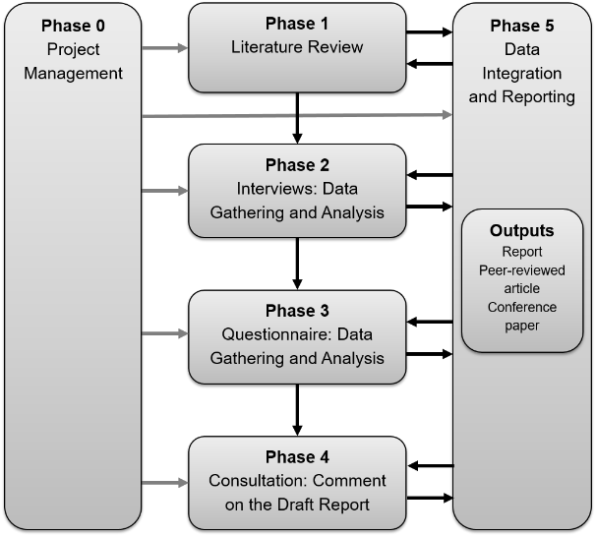
Method: Overview
Notes:
SR

Slide 4
Phase 1: Literature Review
Focused on key reports
ACRL Environmental Scan (2017) and Top Trends (2016)
ARL 2030 Scenarios and Statistical Trends
ARUP Library Futures (2015)
Ithaka S&R Library Survey (2016) and Report (2016)
MIT Report (2016)
NMC Horizon Report (2017)
SCONUL Scenarios Beyond 2020 (2011)
etc
And research and opinion pieces post-2012
Notes:
SR

Slide 5
Phase 2: Interviews
Wide-ranging semi-structured interviews
Conducted May-July 2017
32 interviews (33 participants)
Senior managers and thought leaders representing
Library, IT, Technology and Learning, Educational Policy, Scholarly Communications, Digital Humanities, Estates Management, Academic SNS
23 UK, 10 International
15 women, 18 men
Questions
Drew on key issues arising form the literature
Encouraging participants to think long term
Notes:
SR

Slide 6
Phase 2: Interview Participants
Penny Andrews, PhD student, University of Sheffield
Kirsten Black, Director of Student and Learning Support, University of Sunderland
Chris Bourg, Director of Libraries, MIT, USA
Caroline Brazier, Chief Librarian, British Library
Marshall Breeding, Founder and Editor, Library Technology Guides, USA
Prof Sheila Corrall, University of Pittsburgh, USA
Lorcan Dempsey, Vice President, Membership and Research and Chief Strategist, OCLC, USA
Prof Sir Ian Diamond, Principal and Vice-Chancellor, University of Aberdeen
Liam Earney, Director of Jisc Collections and Head of Library Support Services, Jisc
Heidi Fraser-Krauss, Director of Information Services and University Librarian, University of York
Martin Hamilton, Resident Futurist, Jisc
Bob Harrison, Director, Support for Education and Training
Fiona Harvey, Education Development Manager, University of Southampton; Chair of ALT
Sue Holmes, Director of Estates and Facilities, Oxford Brookes University; Chair of the Association for Directors of Estates
Anne Horn, Director of Library Services, University of Sheffield
Dr Wolfram Horstmann, Director, Göttingen State and University Library, Germany
Chris Keene, Library and Scholarly Futures, Jisc
Dr Donna Lanclos, Associate Professor for Anthropological Research, Atkins Library at UNC Charlotte, USA
Clifford Lynch, Executive Director, Coalition for Networked Information, USA
John MacColl, University Librarian and Director of Library Services, University of St Andrews; Chair of Research Libraries UK
Prof Wyn Morgan, Professor of Economics and Pro Vice-Chancellor for Learning and Teaching, University of Sheffield
Prof Neil Morris, Chair of Educational Technology, Innovation and Change in the School of Education, and Director of Digital Learning, University of Leeds
Prof David Nicholas, Director CIBER Research
Emily Nunn, PhD student, University of Sheffield
Chris Powis, Head of Library and Learning Services, University of Northampton
Dr Richard Price, Founder, Academia.edu
Dr Jason Priem, Co-Founder, Impactstory
Andy Priestner, Director, Andy Priestner Training and Consulting
Kira Stine Hansen, Deputy Director General, University of Copenhagen, Royal Danish library, Denmark
Prof Simon Tanner, Professor of Digital Cultural Heritage, King’s College London
Lynne Tucker, Interim Chief Information Officer, Goldsmith’s, University of London
Caroline Williams, Director of Libraries, Research and Learning Resources, University of Nottingham
Nicola Wright, Director of Library Services, London School of Economics and Political Science (LSE)
Notes:
SR

Slide 7
Phase 3: Survey
Survey conducted online, July-August 2017
261 usable responses
Questions
Focused on issues arising from the literature and interviews
Testing out some views expressed by interviewees with a wider library audience
Notes:
SR

Slide 8
Phase 3: Survey Demographics
 | Count | Percentage
Institution
Post 1992 | 120 | 46
Non-Russell Group pre-1992 | 72 | 28
Russell Group | 69 | 26
Size
Under 5,000 | 21 | 8
5001 to 29,999 | 209 | 80
Over 30,000 | 31 | 12
Senior Management team
Yes | 114 | 44
No | 147 | 56
Years in position
5 years of less | 143 | 55
6-10 years | 52 | 20
11+ years | 66 | 25
Age
18-25 | 2 | 1
26-35 | 37 | 14
36-45 | 69 | 26
46-55 | 100 | 38
55-65 | 50 | 19
65+ | 1 | 0
Prefer not to say | 2 | 1
Gender
Female | 181 | 69
Male | 73 | 28
Other | 0 | 0
Prefer not to say | 7 | 3
Notes:
SR

Slide 9
Analysis
Qualitative:
Interviews fully transcribed
‘Vignettes’
Thematic analysis
Quantitative:
Descriptive analysis
Statistical tests
Integration:
Identification of ‘meta-inferences’
Phase 4: Consultation
Notes:
SR

Slide 10
Report
Structure:
Identifying the Trends
Recognising the Challenges and Opportunities
Positioning the Library
Communicating and Changing
Questioning Old ‘Mantras’, Building New Paradigms
Developing the Role of SCONUL
Conclusions and Recommendations
Approach:
Combining qualitative and quantitative data
Aiming to highlight key findings not be exhaustive
Reflecting the constructive but challenging tone of our participants
Notes:
AC

Slide 11
Report
Structure:
Identifying the Trends
Recognising the Challenges and Opportunities
Positioning the Library
Communicating and Changing
Questioning Old ‘Mantras’, Building New Paradigms
Developing the Role of SCONUL
Conclusions and Recommendations
Notes:
AC

Slide 12
Trends
There is awareness of a large number of inter-related trends impacting libraries but little agreement on what is most important
Very wide range of responses in interviews
Political, economic, social, technological, library-specific
Technology important but rarely seen as decisive
Complex inter-relationships between factors
Some trends recurred but little consensus
Difficult to know where to focus attention
Notes:
AC

Slide 13
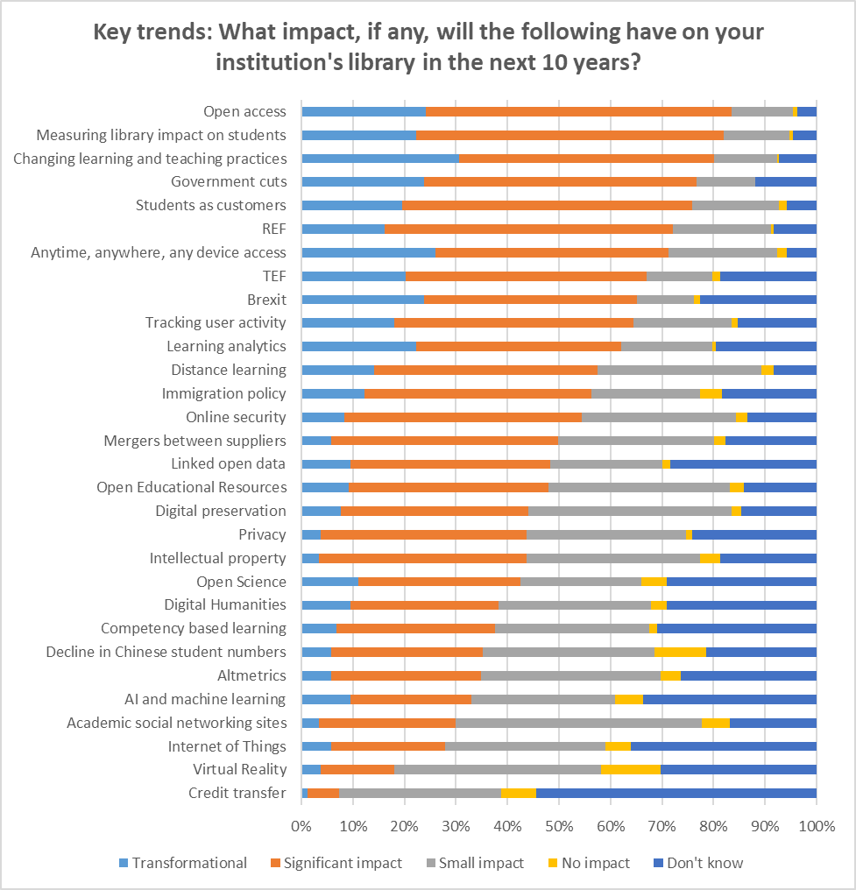
Key Trends and Their Potential Impact
Some agreement on key trends e.g. OA, changing L&T practices, political environment
However, many trends considered significant and so no clear consensus on what is important
Nearly all trends considered by some to be transformational but only for a minority in every case
Notes:
AC

Slide 14
Complex Interrelationships of Trends
“Well I couldn’t get down to two or three [trends]…I always start by thinking about what is going on in teaching in my own institution what is going on in research and then you know I can’t help thinking about technology and changing student behaviour and rising costs…but more and more I find it really difficult to work out what to put my attention to, what is the most important and there is so many things competing for attention.” (Library Manager)
“…all those things and all those things coming together.” (Library Commentator)
Notes:
AC

Slide 15
Nexuses
It is often a nexus of different trends that brings significant change
Nexuses emerging from our analysis:
Nexus 1: Datafied scholarship
Nexus 2: Connected learning
Nexus 3: Service-oriented libraries
Nexus 4: Blurred identities
Nexus 5: Intensified contextual pressures
Notes:
SP

Slide 16
Nexuses
Nexus 1: ‘Datafied’ scholarship
Research increasingly underpinned by large datasets and digital artefacts, involving open, networked, algorithmically-driven systems
Nexus 2: Connected learning
New pedagogies supported by technology-enabled flexible learning
Nexus 3: Service-oriented libraries
Libraries shifting their strategic emphasis from collections to services
Nexus 4: Blurred identities
Boundaries between professional groups and services being broken down with more collaboration and new skills development
Nexus 5: Intensified contextual pressures
A myriad of political, economic and other pressures creating demands on higher education and libraries
Notes:
SP

Slide 17
Report
Structure:
Identifying the Trends
Recognising the Challenges and Opportunities
Positioning the Library
Communicating and Changing
Questioning Old ‘Mantras’, Building New Paradigms
Developing the Role of SCONUL
Conclusions and Recommendations
Notes:
SR

Slide 18
Expecting Continuity?
When we look at how our participants conceive of the library of the future, it looks for many very similar to what exists now
Most library staff believe the library will continue to be a physical presence and there will be a separate building called the library
This view arguably shaped responses to many of the other issues we raised in our research
Notes:
SR

Slide 19
Expecting Continuity?
“They are still flocking into our buildings. And because that hasn’t changed over the last few years I don’t think it is going to change into the future unless something radically different happens.” (Library Manager)
“The actual things that people need libraries for is remarkably persistent. I think that what shifts are the different ways that that can be provided…and again just thinking about furniture the most flexible and effective piece of furniture in a library these days is a big table. And, there have been big tables in libraries since there have been libraries.” (Library Commentator)
Notes:
SR

Slide 20
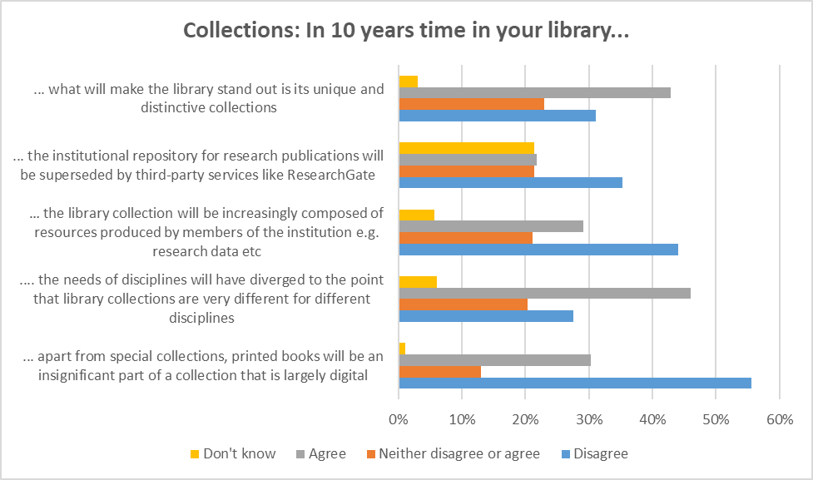
Collections
Libraries are seen by many of our participants as continuing to house significant numbers of physical items
Notes:
SR

Slide 21
Digital Shift
Libraries could usefully work towards greater clarity about the print-electronic shift and how it is being strategised and managed
Balance between print and electronic changing but little consensus about when or where such change will end
Some librarians see professional identity and the role of their library service as intimately connected with the printed book
Libraries could usefully set up discussions internally and with users to develop clearer strategies and policies on the print-electronic shift
Notes:
SR

Slide 22
Virtual Places
Libraries are yet to create successful virtual ‘places’ to mirror the physical
Libraries have failed to create a compelling digital presence to match their physical spaces
“These social networking sites for scholars,…clearly scholars are feeling a need to not just post their papers online and pull other papers off of line, they feel the need to create some kind of community. I think the libraries again, because…our goal is to advance knowledge and scholarship and ensure that it is available for the future and so forth…, ours isn’t a profit motive, I think that…we would be really smart to become players in that realm, in creating these sort of online communities around the scholarship. I do think it is quite rare, I think that libraries have tried things that haven’t…in terms of creating social interaction through their catalogue, for example, or other things, kind of haven’t gone very far, and so they have sort of retreated…but I hope and I expect that in the next 10 years there will be more different experiments in that realm.” (Library Manager)
This is likely to be challenging and would require extensive collaborations
Notes:
SR

Slide 23
Collections to Services
Interviewees agreed there is a need for libraries to shift from emphasising collections to services (or collections as one service)
“[The library] will have to be much more used to providing a diversity of services based on a variety of contractual arrangements. They will have to see their collections as one service among others.” (Library Commentator)
“Libraries will face an important choice over the next several years as an institution of whether or not they want to continue to build their prestige around the size of their acquisitions budget, in which case their prestige will significantly decline in the centrality and importance …, or whether libraries want to position themselves as important to the knowledge creating task of the university in different ways.” (Non-Library Participant)
Notes:
SR

Slide 24
Inside-Out Libraries
There is agreement that the ‘inside-out’ role of libraries needs to be increasingly important
“Outside-in”: traditional role of libraries – selecting and acquiring externally-produced materials and bringing them into the institution for internal users
“Inside-out”: taking internally-produced resources and making them available to external users
Involvement in the “process” and “products” of research and learning
“…it seems to me that there is going to be a role for many universities for the library to become the place where a lot of information in the university is disseminated from and that seems to be also to be a good thing.” (Non-Library Participant)
This needs to be carefully negotiated with users in order not to be seen as constraining or managerialist
Notes:
AC

Slide 25
Outside-In / Inside-Out Balance
But the ‘inside-out’ role will not replace the ‘outside-in’ role
Inside out role are likely to replace outside-in as long as libraries are purchasing and licensing resources
Also, the balance will depend on institutional context of the library:
“I believe that research libraries in particular are going to pay a lot more attention to local assets. But you know I don’t buy that they are going to get out of the other role. Non-research libraries mostly don’t have any content to curate, except for teaching and learning materials.” (Library Commentator)
Notes:
AC

Slide 26
Discovery
Participants thought the library’s role in discovery in a networked world needs greater clarification and focus
The library’s traditional role in discovery, delivered primarily through its catalogue(s), looks increasingly insecure
The value of libraries attempting to in some way compete with such network-level discovery services (something often implicit in library approaches) seems doubtful
Greater emphasis should be placed on designing ways in which library content can be surfaced where users actually are – “The library in the life of the user”
Notes:
AC

Slide 27
Gaps and Innovation
Apparent gaps in awareness about certain key trends need to be addressed
​AI, TDM etc have the potential in many ways to replace the well-established methods of dissemination and discovery in the current environment
Academic SNSs now dwarf institutional repositories in terms of making copies of publications available openly on the web
Big global challenges of our time are around water, food and energy
Notes:
AC

Slide 28
Isolation, Innovation, Long-Term Thinking
The view was expressed that the library profession would benefit from being more outward-looking
Libraries are seen as “isolated” from other professional groups
Often focus on incremental rather than disruptive change
“The library [needs to be] a learning, adaptive and responsive organisation” (Library Manager)
Part of this is thinking long-term
Thinking long-term is an important part of recognising current challenges
Libraries often constrained by 3-5 year planning windows
Notes:
AC

Slide 29
McDonaldisation?
There are contrasting attitudes to the claim that libraries are being ‘McDonaldised’
Library services often viewed in commodified way – libraries as businesses, users as customers, etc
Growing importance of managerialist culture – metricisation, KPIs, etc
Acceptance of the reality?
“We do run quite a business minded service here…I have long ago given up being precious about it” (Library Manager)
Resistance?
Notes:
AC

Slide 30
Report
Structure:
Identifying the Trends
Recognising the Challenges and Opportunities
Positioning the Library
Communicating and Changing
Questioning Old ‘Mantras’, Building New Paradigms
Developing the Role of SCONUL
Conclusions and Recommendations
Notes:
SP

Slide 31
The Need for Alignment
There was widespread agreement that libraries need to align closely with their institution
“I mean fundamentally the library should absolutely be supporting and serving the institution, that first and foremost, that is its job, so anything that affects…the way that academics are conducting research, the way that the students are coming into the university, and the way that they are being taught and everything, it all should affect the library and if it doesn’t the library isn’t doing its [job]” (Library Manager)
“You don’t have libraries like that, that stand on their own and change over time like independent businesses or something. You have libraries that are part of institutions, and those institutions are going to change and the most important thing that will affect the library is what the institution requires of it.” (Library Commentator)
Notes:
SP

Slide 32
Alignment and the Institution
Major differences in priorities between institution types did not emerge in the data
Major variations by type of institution might be expected to emerge but they did not
Libraries in teaching-led HEIs tended to emphasise the importance of the library’s provision of services such as “academic literacy/study skills”, and the libraries in research-led HEIs “research data management”, but the levels of differentiation were small
Notes:
SP

Slide 33
Aligned Does not Mean ‘Reactive’
Libraries should not be merely reactive – they have the ability to provide leadership in key areas in their institutions
“So it is about that balance of aligning with institutional objectives and creating a library service that is innovating and is right for today’s age…” (Non-Library Participant)
“I think where you can see libraries that have been successful it is where library directors have adopted that sort of entrepreneurial mindset but have persuaded the institution of the direction. They have brought the institution along with them, they haven’t been doing stuff on the side and hoping that the institution will notice.” (Library Commentator)
“But it is not just up to librarians to respond, I think librarians need to be driving and pushing these external factors along. So I think we need to be stepping up and making educators, researchers and students want to work in different ways and offer them different ways in which they can work. So I don’t think we should be passive in this, because never mind 10 years I mean 6 months something could change … but we really need to be on the front foot I don’t think you can be passive in this.” (Library Manager)
Notes:
SP

Slide 34
Styles of Alignment
We propose that libraries need to position themselves in different styles of alignment in different contexts: service provider, partner and leader
Service-provider: delivering key services and support activities required by users in line with institutional requirements, often at scale
Partner: working alongside users and other professional services organisations, often through projects or embedded working
Leader: innovating in new areas, persuading key stakeholders of the way forward and contributing to overall institutional strategy, creating and communicating a compelling vision
Notes:
SP

Slide 35
Report
Structure:
Identifying the Trends
Recognising the Challenges and Opportunities
Positioning the Library
Communicating and Changing
Questioning Old ‘Mantras’, Building New Paradigms
Developing the Role of SCONUL
Conclusions and Recommendations
Notes:
SR

Slide 36
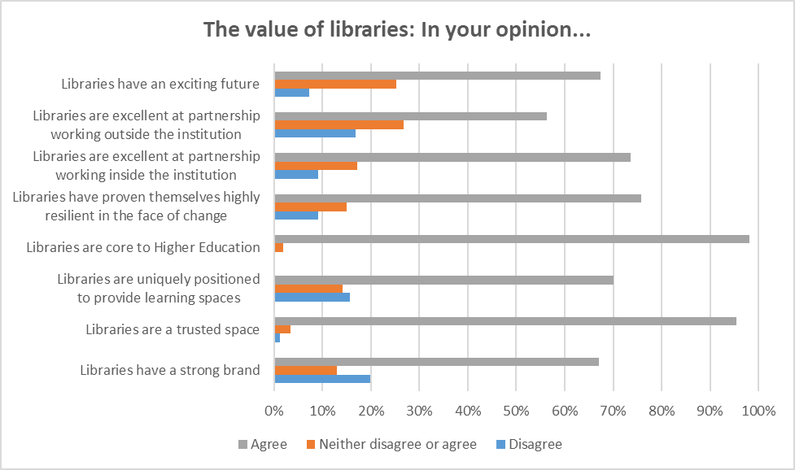
The Value of Libraries
Library professionals are positive about future and about the value of their skills
“I think actually there will be more libraries, better libraries. I think that actually we might be coming into almost a bit of a golden age for libraries…” (Library Commentator)
Notes:
SR

Slide 37
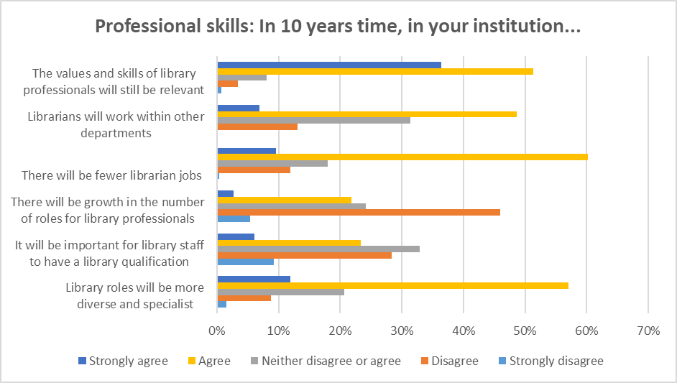
Fewer Jobs and Changing Roles
Despite the optimism, there is a belief that there may be fewer library jobs in future, and the skills required will change
Survey participants saw continuity and change in skills and roles
A radical view was expressed by some:
“So everything from ordering books to cataloguing books etc, answering queries I think software is going to replace people.” (Non-Library Participant)
Notes:
SR

Slide 38
Optimism or Pessimism?
However, optimism about the future of libraries was not always shared by participants from beyond libraries
“So I think that, the library services themselves will be a more competitive environment and I think that, what I guess I am implying there is that the library as it is now won’t exist, it will consist of a series of services it will itself become unbundled, and the physical entities that we call libraries will be, will be part of what you get when you come on campus and it will be part of the value proposition. But the digital who knows whether a library will continue to offer those services, against the competition that it would face in the market.” (Non-Library Participant)
With such dichotomous views, it seems that perhaps either library professionals are overly optimistic about the future of libraries or there is misunderstanding among those outside the library about the library’s role – or both
Notes:
SR

Slide 39
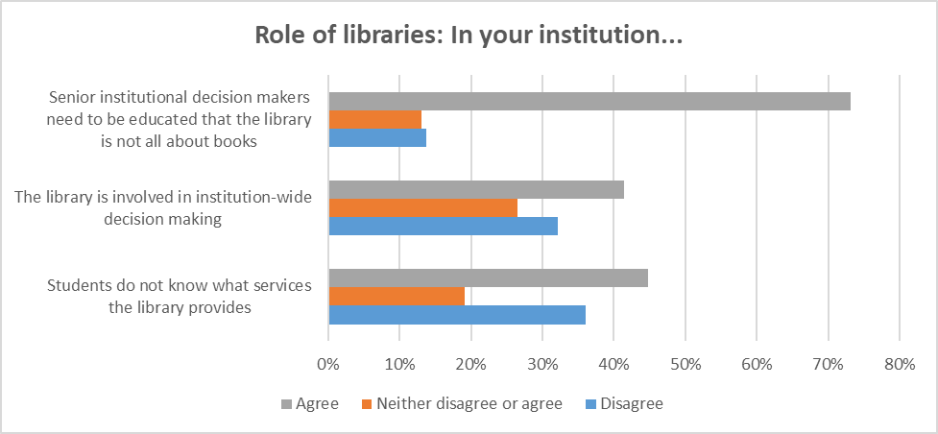
Lack of Understanding of Libraries from Outside
There is disagreement about what the library is and does
Some non-library-participants saw ‘the library’ in very traditional terms – “old fashioned”
“The university, they are not aware of what we are doing when we are not a physical building.” (Library Manager)
Misunderstanding seems to be contributing to perceptions of diminishing relevance of the library
Notes:
SR

Slide 40
Creating and Communicating a Compelling Vision
Participants recognised a need for libraries to communicate their current and future role better
“People being wedded to that old model of the library is something that really holds libraries back. And I think we need to think about working with vice chancellors, working with PVCs for research, teaching learning and so on… we need to do a lot of work I think with those communities to get people to…be happy about moving away from old legacy models which give us huge unnecessary collection management building, storage problems…we could be faster, more flexible and more fleet-of-foot if we could move away from some of that. But we need to take those people with us. And I think that will be hard to do.” (Library Manager)
There is clearly a need to create and communicate a compelling vision of the library’s current and future role in the institution which can take stakeholders along with the library
Notes:
SR

Slide 41
Credibility and Influence
There are key questions about the credibility and influence of the library in institutions
Some participants reported explicit endorsement from senior levels in the institution
“I don’t move without the buy-in from the people at the top.” (Library Manager)
But there was a sense of what the Ithaka S&R survey report calls “a decreasing sense of support from the institution”
“I sit on the board of my university and the number of questions that come up about or the number of issues that relate to the library at the top table in terms of a risk or an issue, or dare I say it, an interest is hardly any.” (Non-Library Participant)
Notes:
SR

Slide 42
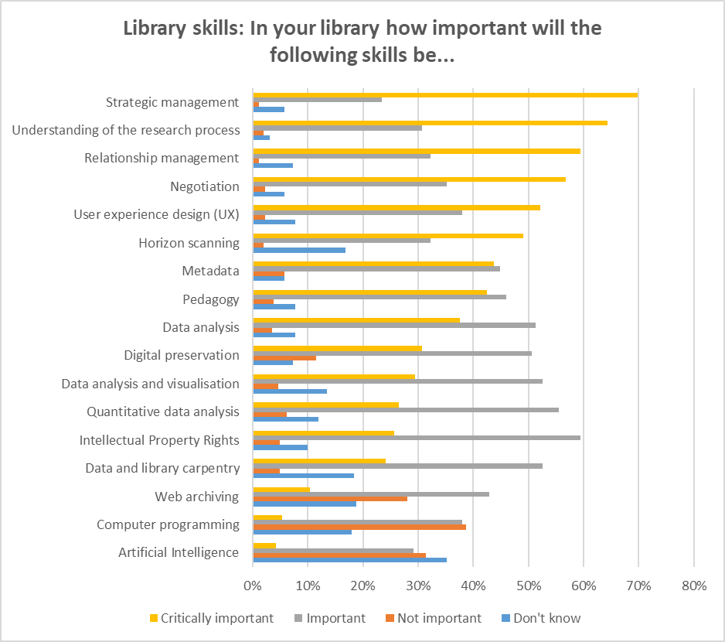
The Change Imperative
Participants were clear that there was a need for libraries and library professionals to adapt
“If we keep doing what we have done in the way that we have always done it,…we will fall off the map.” (Library Commentator)
Part of this is having the right skills in the organisation
Survey participants saw ‘softer’ skills as key
Notes:
AC

Slide 43
Resistance to Change
There may sometimes be resistance to change in libraries
“If only university libraries could see the excitement of change. Libraries don’t like change. It’s like turning around the titanic.” (Library Commentator)
“How do you get mindsets opened up so that we are not defensive that we are proactive and open, and not defensive of our own traditional practice. I think we should be defensive of the values that we aspire to in terms of access to information and sharing of that information, but the way that we do it, I think can be very different, and we really need to be open to that. You know open up to that the professional practices that we have been taught over the years may not be the right ones for the future.” (Library Manager)
Developing such an open-mindedness and a culture of flexibility within the profession was seen by many as essential for its future
Notes:
AC

Slide 44
Strong Library Collaborations
Libraries can build on existing strong consortial and partnership networks
Libraries have a strong record of inter-library collaboration – these are likely to become more important
They are likely to operate at “local,…national and …international” levels
“I think you will, you will see libraries wanting to procure shared systems, wanting to manage their collections in a shared way, wanting to share expertise,…I think that is much more observable in the US because of consortia nature of things, but you can see it happening in the UK as well.” (Library Commentator)
Shared approaches might head-off calls for outsourcing:
“Maybe libraries could help themselves to some extent by if they do engage in this sharing already then that could stop this hard edged you know institution or sector wide push towards outsourcing.” (Non-Library Participant)
Notes:
AC

Slide 45
Collaboration and the Preservation ‘Crisis’
Partnerships will be needed to address increasingly important preservation challenges for non-print materials
Collaborative initiatives are likely to be needed to curate born-digital materials for the long-term
There was seen to be an urgent need to address this challenge in a meaningful way
“So there is a massive crisis unfolding in terms of preserving the cultural record for future scholars and I believe that that is going to be a centre challenge for research libraries in the coming years.” (Library Commentator)
Responding to such a challenge also needs action at different levels: institutional, consortial, national and international:
“Preserving that record of scholarship is something that is a big challenge, and it requires international concerted international action. It is not something that I think would make any sense for the UK to try to do on its own.” (Library Manager)
Notes:
AC

Slide 46
Multi-Professional Collaborations
Multi-professional collaborations within the library and partnerships beyond are also seen as crucial
This is happening within the library, with library organisations becoming more multi-professional
“There is barely any library that is only containing librarians. I mean I have got learning technologists in here, I have got an enterprise [support unit], I have got learning and development academic skills tutors, all of them I either manage or have space in here.” (Library Manager)
Collaborations beyond the library are common but were seen as needing to be strengthened
“[The library] has to become much more adept at creating internal alliances, internal partnerships, internal divisions of responsibility to move things along and get things done.” (Library Commentator)
Notes:
AC

Slide 47
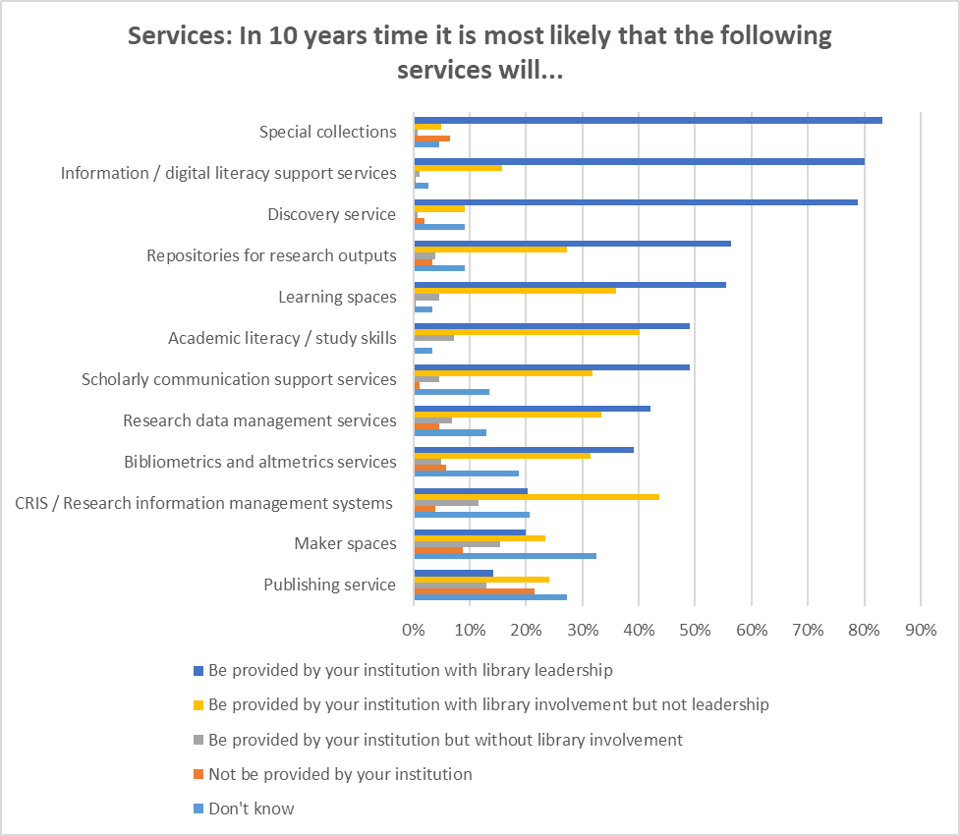
The Need for ‘Coopetition’
A balance needs to struck between collaboration and competition with other professional groups
Professional groups compete for “jurisdiction” in new areas as well as needing to collaborate e.g. RDM
Libraries need to navigate this ‘coopetition’ – cooperation and competition combined
Existing services may also become contested e.g. learning spaces
Notes:
AC

Slide 48
Report
Structure:
Identifying the Trends
Recognising the Challenges and Opportunities
Positioning the Library
Communicating and Changing
Questioning Old ‘Mantras’, Building New Paradigms
Developing the Role of SCONUL
Conclusions and Recommendations
Notes:
SP

Slide 49
Questioning Library Mantras
We propose such traditional library ‘mantras’ should be questioned as part of libraries challenging themselves to respond to the rapidly-changing environment in which they operate:
Mantra 1: ‘The library is a strong brand’
Mantra 2: ‘The library is neutral’
Mantra 3: ‘The library is trusted’
Mantra 4: ‘Library spaces are unique’
Mantra 5: ‘The library provides for discovery of information’
Notes:
SP

Slide 50
Building New Paradigms
Paradigm 1:
The hybrid library
Paradigm 2:
The inside-out library
Paradigm 3:
The library in the life of the user
Paradigm 4:
The library as platform
Paradigm 5:
The library as infrastructure
Paradigm 6:
The computational library
Paradigm 7:
The service-oriented library
Paradigm 8:
The library as digital third space
Paradigm 9:
The globalised library
Paradigm 10:
The boundaryless library
Notes:
AC

Slide 51
Report
Structure:
Identifying the Trends
Recognising the Challenges and Opportunities
Positioning the Library
Communicating and Changing
Questioning Old ‘Mantras’, Building New Paradigms
Developing the Role of SCONUL
Conclusions and Recommendations
Notes:
AC

Slide 52
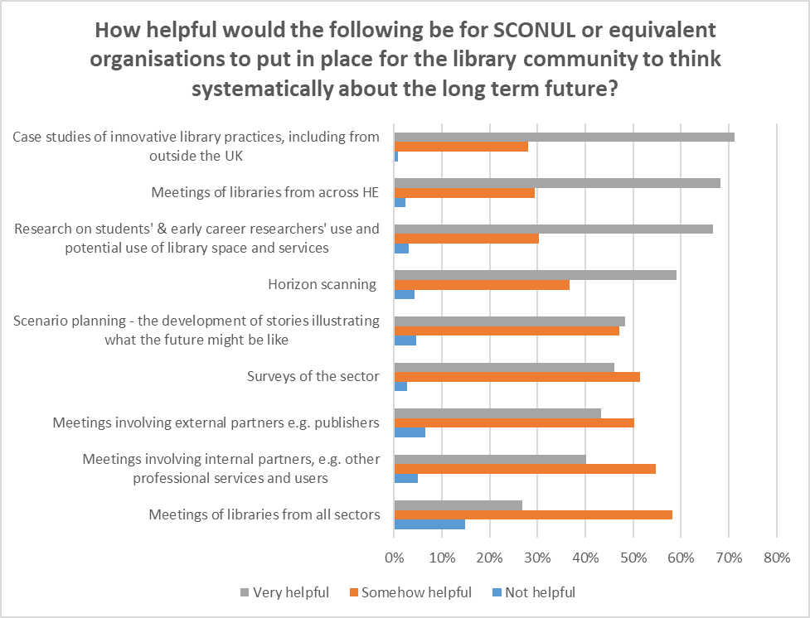
Role of SCONUL
The importance of creating spaces for more long-term thinking around transformational change
Notes:
AC

Slide 53
Report
Structure:
Identifying the Trends
Recognising the Challenges and Opportunities
Positioning the Library
Communicating and Changing
Questioning Old ‘Mantras’, Building New Paradigms
Developing the Role of SCONUL
Conclusions and Recommendations
Notes:
AC

Slide 54
Paradoxes (1)
Participants identified a wide range of potentially transformative trends for libraries, but there was no consensus about which trends were most important.
Some key nexuses of change can be identified, but the end game for each remains unclear.
Despite the recognition of potential for change, images of the library of the future seemed rather similar to what exists now.
Despite many trends being recognised, some key transformational forces, such as AI, were not widely understood.
Library spaces are seen as unique and valuable, but library digital spaces are far from compelling.
Libraries see themselves as good at collaboration but are often too insular.
Libraries see themselves as forward looking but often fail to engage in truly innovative thinking and risk taking.
Notes:
AC

Slide 55
Paradoxes (2)
There was agreement that alignment to the institution was essential, but we suggest there are three radically different styles of alignment.
Library Participants were optimistic about the future of libraries, but Non-Library Participants less so.
The need for change is widely recognised, but so is the existence of resistance to change.
Libraries have to respond to the immediate needs of users but have a growing challenge of preserving born-digital objects.
There is a need to both collaborate and compete with other departments and organisations.
Collaboration is increasingly necessary to deliver library services but can contribute to the erosion of the library’s identity.
There is wide support for some mantras about the value of libraries, but in reality these need to be questioned.
Notes:
AC

Slide 56
Recommendations for Academic Libraries (1)
Work with stakeholders such as user communities and colleagues in other professional groups to undertake more analysis of key trends that affect them and their institutions, especially environmental factors and more long-term issues.
Set in motion processes, especially consultation with users, to develop more clarity around the print-electronic shift and how it is likely to develop over time in order to inform strategy and policy formulation.
Investigate the possibilities of developing collaborations to create meaningful online scholarly venues to complement library physical spaces.
Review local responses to the shift from collections to services in order to position the library effectively in the institution.
Examine the implications of the “inside-out” library and its relative prioritisation over time against “outside-in” functions.
Review the library’s role in discovery, in particular developing ways of surfacing library content in network discovery tools, and developing services using new discovery and analytical approaches, such as TDM.
Notes:
SP

Slide 57
Recommendations for Academic Libraries (2)
Carry out more work on examining the significance of key developments such as AI, machine learning, internet of things, digital humanities, and other areas of datafied scholarship, and begin to develop services in these areas.
Consider how best to achieve the roles of service-provider, partner and leader, and get the emphasis right between them, in the institutional context.
Debate the meaning of the ten paradigms that envision what libraries can be in the institutional context.
Consider how a compelling vision of the library can be created for communication to the wider institution.
Create opportunities for high-risk innovation and longer-term thinking.
Investigate how cultures encouraging flexibility and innovation can be encouraged in libraries without undermining necessary established processes and routines.
Notes:
SP

Slide 58
Recommendations for Academic Libraries (3)
Develop ways of making the preservation of born-digital materials one of the major priorities of the library community, considering the appropriate level for activity (institutional, regional, national or international) and how these can be coordinated.
Consider the balance between collaboration and competition with other institutional professional services departments as well as external providers in relation to new and existing services.
Focus on developing clear messages about the value the library adds in providing particular services to the institution and ensure library staff are equipped to communicate these messages.
Review the library’s current staff skills base in the light of these recommendations.
Notes:
SP

Slide 59
Recommendations for SCONUL (1)
Promote further discussion of the current report.
Work with other partners to harness expertise and capacity for horizon scanning.
Promote greater understanding of trends whose implications for libraries appear to be less well understood, such as artificial intelligence, machine learning, TDM or wider environmental trends.
Host more discussion around potential end-points arising from the complex nexuses of change, the validity of the five mantras and the implications of the 10 paradigms defined in this report.
Promote more discussion around key issues such as the role of library space, the balance between print and electronic and the balance between collections and services.
Host more discussion around how, given the need to align to institutional priorities and different styles of alignment (service-provider, partner and leader), different types of academic library might respond in different ways to current changes.
Notes:
SP

Slide 60
Recommendations for SCONUL (2)
Promote the sharing of best practice in (a) explaining the changing nature of the role of the library to stakeholders; and (b) managing disruptive change.
Review skills required for the further development of the role of libraries in the sector and analyse training and recruitment patterns to ensure libraries are future-ready.
Promote and facilitate the interaction of the SCONUL community with other key communities among internal and external stakeholders (e.g. estates, IT and publishers), involving user communities.
Work to create more opportunities for more collective long-term thinking.
Sponsor the creation and discussion of case studies of new practices (including from outside the UK).
Sponsor research on trends in user behaviours, e.g. among undergraduates and researchers.
Notes:
SP

Slide 61
#mappingacademiclibraries
https://www.sconul.ac.uk/news/mapping-the-future-of-academic-libraries
Notes:
SP

