Slide 1
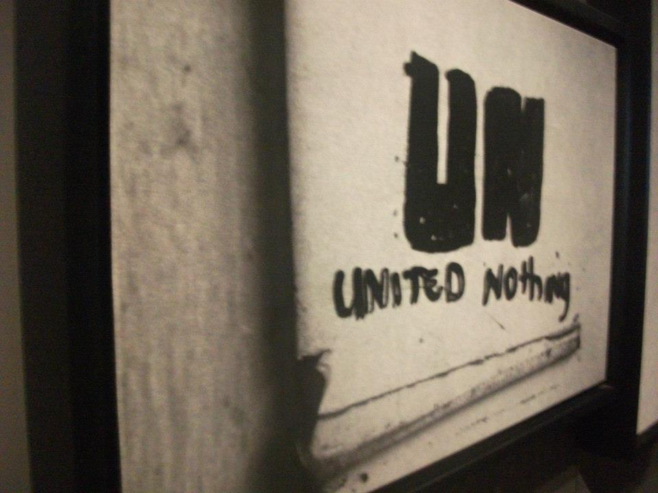
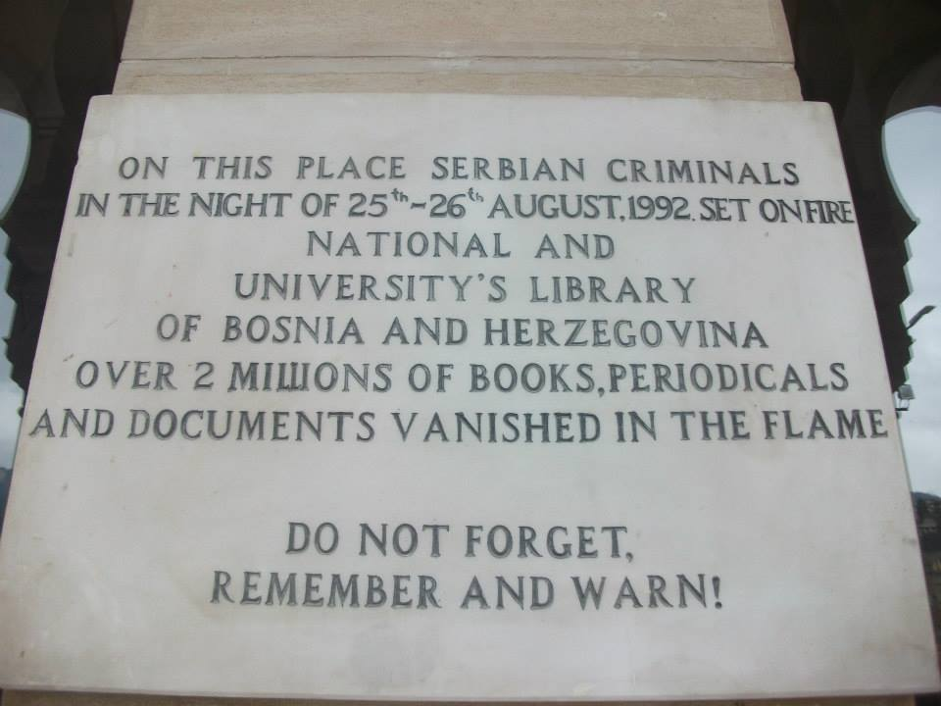
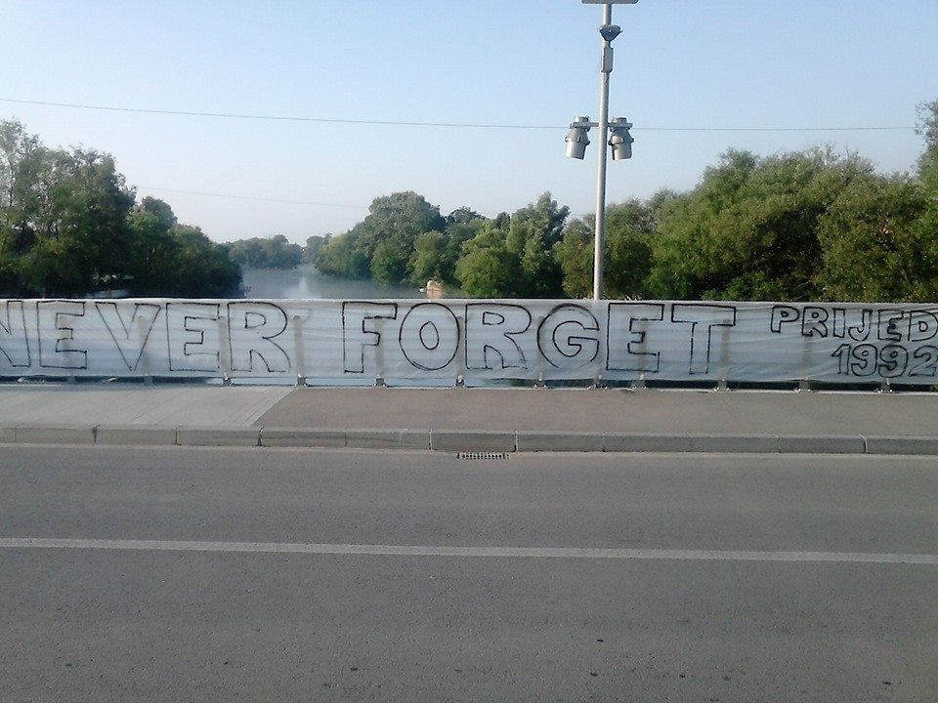
Aim: to look at how the term reconciliation is perceived and implemented by international, national and local agents involved in the construction of peace in Bosnia-Herzegovina.
Question: How has reconciliation been understood by different actors in Bosnia and how do these understandings contribute or limit the strengthening of state-society relations?
Sub-Questions:
How through different views around reconciliation practice can we see areas of convergence and divergence between international, national and local peace-building practice?
What are the possible linkages between high level politics and grassroots efforts towards interethnic reconciliation in Bosnia?
Contribution: By critically looking at the interplay between issues of truth, justice and reconciliation in Bosnia, this research intends to map the converging and diverging points between different practices of reconciliation in the country.
The project intends to connect international state-building practices with local (community-based) efforts around reconciliation to see new possibilities for sustainable peace-building in Bosnia.
The project aims to contribute to the field of international relations and peace research by approaching reconciliation through a discourse analysis that seeks to understand the meaning of reconciliation and its implications for peacebuilding practice.
In regards to Bosnia, a thoroughly researched topic in peace studies, the project innovates by using a narrative approach to understanding truth, justice and reconciliation contributing to the understanding of peace as a working concept in the country.
Method: Semi-structured interviews with agents involved in reconciliation initiatives in Bosnia-Herzegovina and beneficiaries of reconciliation projects in the country.
The analysis will assess how different meanings give importance to specific values in the practice of reconciliation (truth-telling, relationship-building, trust, legal or communal practices around justice, political dialogue, accountability).
As a main outcome of the project a nexus between state-building and reconciliation is proposed, one that links the establishment of institutions and political arrangements with the implementation of ground projects that are aimed at peaceful coexistence and interethnic reconciliation between Bosniaks, Bosnian-Serbs and Bosnian-Croats.

