Slide 1
Preparing for your thesis submission
Research Student Administration
Registry
Academic Services

Slide 2
Thesis examinations: regulations and deadlines
The relevant regulation to look at is section 7 of the University regulations: Assessment, Progression and Award (7.4 Research Degree Programmes – Assessment and Award)
There is also a code of practice on the assessment of research degree theses
See our page on regulations and codes of practice
Do you know your submission deadline?
It is the end of your maximum period of registration
You can find this at the top of your online GRS2 form or
The ‘programme’ tab on online registration
For information on extensions to submission deadlines see the extensions web page.

Slide 3
Intention to submit
Submit your Notice of Intention to Submit (NOITS) form 3 months before your proposed submission date
Download the NOITS form from the Notice of Intention to Submit web page
After you submit the NOITS form, we send a form to your supervisor so that they can nominate your examiners
If you submit the NOITS form late this may delay your thesis examination
If you think you need to restrict access to your thesis, please discuss the access options with your supervisor before submitting your NOITS form. Restricted access requests should be made at this point. You will find forms and guidance about this on the NOITS webpage above.

Slide 4
Nomination of examiners
Your supervisor is responsible for nominating your examiners and for filling in the nomination of examiners form
The criteria for who can act as an examiner are set out in section 4 of the code of practice on the assessment of research degree theses
Your supervisor should consult you on the choices of examiner (see section 2.4 of the code of practice on the assessment of research degree theses above).

Slide 5
Published papers and alternative format theses
You may include published papers in your thesis but please note that:
the material you include from published papers must be appropriately integrated in the body of the thesis or as an appendix to which you make reference
the material must be identified as having been published in a paper and must be referenced.
Please see our alternative format thesis guide for 'Previously published or submitted work'.

Slide 6
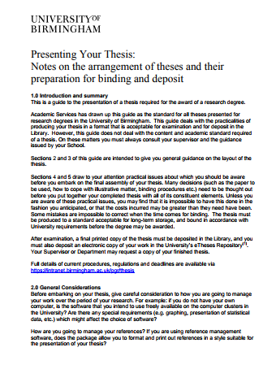
Thesis format
We have produced a guide to presenting your thesis. It includes information on:
page layout
referencing
word count (please note you must not exceed your maximum word count)
Your thesis must be written in English.

Slide 7
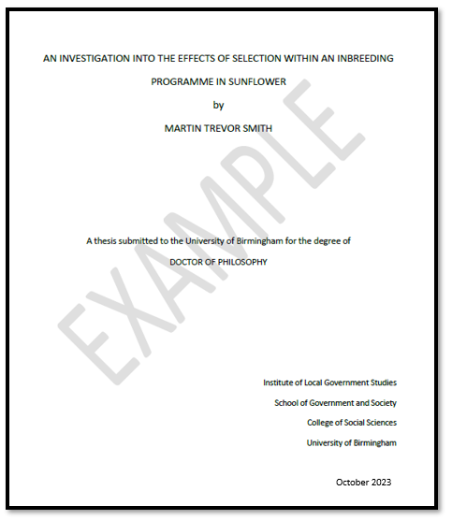
Sample thesis title page

Slide 8
What do I need to submit?
What to submit to your School
An electronic copy of your thesis, which you should submit on Canvas. Your School can advise you on how to do this
What to submit to us in Research Student Administration
Declaration form
Degree congregation choice form
Third party declaration form (if this applies to you)
The above forms are all available through links on the Submitting your thesis webpages.

Slide 9
Must I submit a printed copy of the thesis?
We don’t require printed copies of your thesis. The examination will be conducted using the electronic copy of the thesis you submit to Canvas for the plagiarism check. For details on how to submit your thesis on Canvas, please contact the PGR administrator in your School
However, your examiners may request a printed copy. If they do, we (in Research Student Administration) will contact you to ask you to submit your thesis in printed form as well
If your examiner(s) request printed copies please note the following:
Examination copies should be soft bound – normally with a temporary glued soft binding
The temporary binding must be sufficiently secure to ensure that pages do not fall out during the examination process
Don’t use spiral-binding.

Slide 10
Thesis word count
The following parts of the thesis are not included in the word count:
Abstract
Acknowledgements
Contents pages
Appendices
Tables, diagrams and figures (including associated legends)
List of references
Bibliography
Footnotes and endnotes
Any bound published material

Slide 11
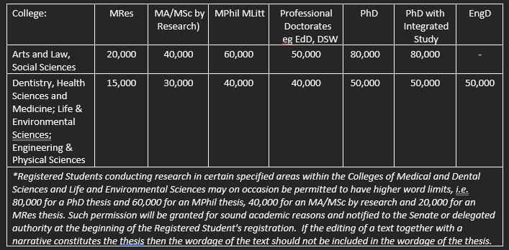
Thesis word count
The maximum word count for each qualification is set out in regulation 7.4.2(d)
We cannot accept for examination a thesis that exceeds the word count set out in our regulations unless you have gained approval from the Research Progress and Awards Sub Panel first

Slide 12
What happens next?
When you submit your thesis submission forms, you will receive an email from us confirming receipt
We will send your thesis to the examiners once we have received or checked the following:
that your School has confirmed that your thesis has passed the plagiarism check
that the examiners nominated by your supervisors meet the criteria set out in University regulations
that any taught requirements that you must meet have been accurately recorded by your School (if this applies to you)
We will send you an email to let you know when we have sent the thesis to the examiners
The examiners are asked to complete the examination within 2 months but in some instances this may be extended.

Slide 13
Viva examinations
Viva examinations are compulsory for all doctoral degrees
For masters by research degrees: the examiners may or may not decide that a viva should be held. However, if they make a recommendation that the student must revise and resubmit the thesis, or they reject it, a viva must be held
The viva may be held in person at the University of Birmingham or by video conferencing
An independent chairperson will be present at the viva
The internal examiner will contact you to arrange a suitable date and time for your viva. If you do not have an internal examiner, the chairperson will be responsible for arranging it
The examiners may confirm their provisional recommendation at the end of the viva
For more information see our page on viva examinations.

Slide 14
Possible viva outcomes
Award
Minor corrections
Major corrections
Revise and resubmit for original or lower degree
Award lower degree with or without corrections
Reject without opportunity for resubmission
You will receive an email from us confirming the outcome of your examination. This will include details of any action you need to take i.e. corrections to be completed and any deadlines.

Slide 15
Corrections
You will receive a letter from us confirming the outcome of your viva and the deadline for your corrections/resubmission (if applicable)
Minor corrections: one month to complete.* These may be errors and omissions of a clerical nature, minor changes in phraseology, small improvements in descriptions or explanations or corrections of faults in subsidiary arguments
Major corrections: six months to complete.* These may involve rewriting sections, correcting calculations or clarifying or amending arguments. It is expected that once the major corrections have been made the thesis will reach the required standard for the degree
You don’t need to declare the word count of a corrected thesis
Revise and resubmit: one year to complete.*
*Examiners may give a longer period.

Slide 16
Revise and resubmit
If ‘revise and resubmit’ is the outcome of the viva, it could mean substantial revisions to the thesis are required involving, for example, rewriting sections, introducing significant new material, more experiments, calculations or research or profoundly correcting an argument.
When resubmitting your thesis, you must resubmit all the forms that were required for your first submission
The revised thesis must not exceed the word count
A resubmission fee, currently £180, is payable on resubmission of the thesis
Another full viva will be held.

Slide 17
Submitting minor and major corrections
You must submit your thesis along with a document detailing how you have completed the corrections
Minor corrections are checked by the internal examiner
If two external examiners were nominated, one of them will be nominated to check the corrections
Major corrections are checked by all examiners
The corrected thesis should be submitted both to us in Research Student Administration and the examiners. The examination outcome letter will tell you if the examiners wish to have a printed copy
If you don’t send corrections to us it may delay the final outcome being communicated to you.

Slide 18
What happens after submission of corrections?
Following the submission of your corrected thesis we will write to you to:
tell you whether your corrections have been completed to the satisfaction of the examiners
tell you what the requirements are for your award
confirm your deadline to submit the e-thesis.

Slide 19
Requirements for award of a research degree
In order to graduate:
the process of examining the thesis must have been concluded
the corrected thesis must have been approved
you should have uploaded the final approved thesis to UBIRA, the eTheses repository. When you deposit your thesis, you will be asked to select an access option. Discuss access options with your supervisor when submitting your notice of intention to submit. The Scholarly Communications Services provide support and FAQs on the process and can be reached by email at ubira@lists.bham.ac.uk
you are no longer required to submit a hardbound copy of your thesis
all outstanding debts to the University must have been paid.

Slide 20
Graduation
Degree congregations are held in July and December each year
Degree congregation choice form
This is one of the forms we ask you to submit when you submit your thesis. There are two options on the form to let us know whether you plan to attend a congregation in person or not:
I wish to have my degree conferred in person at a degree congregation (P)
I do not wish to attend a degree congregation and wish to have my degree conferred in my absence (A)
You won’t receive any email invitation email to a degree congregation. The responses you give on the form tell us whether you plan to attend. The form also includes the deadlines for submitting the choice form and for fulfilling the requirements of the award of the degree in order to be able to graduate in the July or December congregation
If you have fulfilled the requirements for a degree congregation – but you wish to defer your graduation to the congregation after that – please contact us in Research Student Administration
You may use the title Doctor after your degree has been conferred.

Slide 21
Graduation deadlines
To graduate at a July congregation
You must submit your degree congregation choice form by 1 March and complete all the requirements for the award of your degree (including submission of the e-thesis) by mid-June
To graduate at a December congregation
You must submit your degree congregation choice form by 1 October and complete all the requirements for the award of your degree (including submission of the e-thesis) by mid-November

Slide 22
For more information
Thesis submission and examination webpages
Contact us via Student help

Slide 23
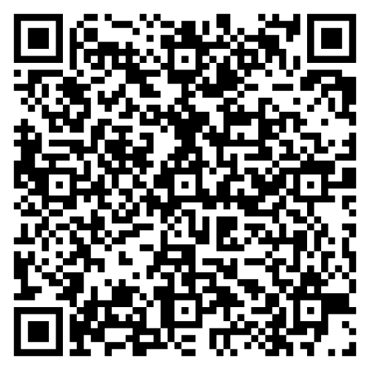
Leave us some feedback and be in with a chance of winning £20 Amazon voucher
We would love to hear what you thought. Please scan here to complete a short feedback form.

