Slide 1
CAREERS NETWORK
Postgraduate Researcher Welcome 2014
Jayne Sharples, Postgraduate Careers Consultant
Debbie White, Events and Projects Manager
Chris Meah, PhD, Computer Science

Slide 2
Today’s presentation
Introduction to Careers Network
Why think about longer term career plans at this early stage
PhD case study
Networking in action – a key skill for career success

Slide 3
Careers Support available to Postgraduates
Postgraduate
Online resources, networking opportunities and workshops
Other Specialist Services
International
College
College team – specialist support for your subject area
PGR – www.intranet.birmingham.ac.uk/careers/pgr
PGT – www.intranet.birmingham.ac.uk/careers/pgt
Advice desk, events, workshops and lots more
Employer Recruitment Fairs and Skills Series
Enterpreneurship and Innovation
Jobs and internships online

Slide 4
An effective career strategy – why start now?
Be strategic - Choose extra activities and skill development in line with your career aims – Vitae Researcher Development Framework
Many researchers report that they valued taking part in training and activities in their first year/ good to get involved
Develop a rounded skill set beyond the Thesis

Slide 5
Building your employability skill set
Your PhD will be of greater value if you develop the wider skill set employers are looking for – for careers in academia and in other sectors
Keep your CV up-to-date as you develop skills and experience
Network and build contacts – on and off campus
Take advantage of training courses – Talent Pool, PESS and Leading Academics

Slide 6
Postgraduate Workshops Autumn 2014
Workshop | Date
CV Writing – update your CV | 15 October 15.00 – 16.30
Work Experience for Postgraduate – what, where, how | 22 October 14.00 – 15.30
Interview skills – prepare to approach job interviews with confidence | 12 November 15.00 – 16.30
Postgraduate careers networking event with employer speaker | 27 November 13.00 – 15.00
Sign up via Careers Connect

Slide 7
Entrepreneurship and Innovation
Coaching and mentoring and access to professional networks
Courses for Postgraduates such as:
- Talent Pool
- Postgraduate Enterprise Summer School
- Leading Academics - www.intranet.birmingham.ac.uk/ei
Tel: 0121 414 8775
Email: ei@contacts.bham.ac.uk
Web: www.ei.bham.ac.uk

Slide 8
Entrepreneurship & Innovation Workshops Autumn 2014
Workshop | Date
Create your own work experience (part of Autumn Action Week) | 24 October 13:00 – 14:00
Change the world with an idea (after Autumn Action Week) | 29 October 13.00 – 14.00
A Brain for Business - How to create and develop winning ideas with Mike Bandar | 4 November (time tbc)
The Idea Accelerator - Transform your idea into a viable business with Mike Bandar | 11 November (time tbc)
Skills to start your own business - Weekend Pizza Start up | 14 & 15 November (All day)

Slide 9
Training Programmes
Leading Academics – Inspirational speaker series – June 2015
Are you a doctoral researcher interested in developing your leadership potential either in academia or outside?
This series will give you the opportunity to engage with guest speakers on how they have made it to the top, the issues they face and have overcome.
Talent Pool – Enterprise Skills Training – January and May/June
Introduction to Enterprise Skills (3 days)
Learn crucial enterprise skills that can help you succeed in whatever career.
Advanced - Consultancy Skills (2 days)
Here you will learn what skills that are needed to become a successful consultant.
By undertaking a PhD you are gaining a specialism that means you can become ‘consultants’ in your specialist areas.
The Postgraduate Enterprise Summer School (PESS) - July 2015
An intensive week-long programme provides a fantastic opportunity for top quality training alongside the opportunity to work on real strategic issues with a local organisation…

Slide 10
Case Study Chris Meah -PhD Computer Science

Slide 11
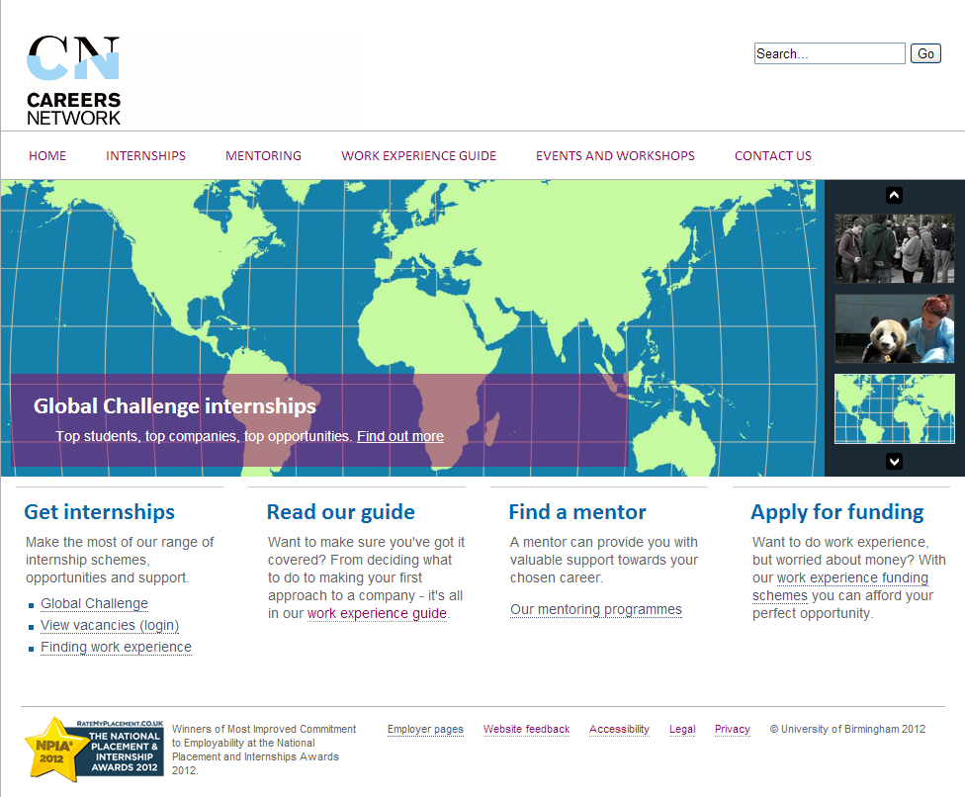
“Careers Connect” – opportunities database
www.birmingham.ac.uk/internships

Slide 12
International Careers Support
Enhanced service for International Students – led by Ellen O’Brien, International Careers Adviser
To create
Knowledgeable and confident global workforce
UK and International Labour Market Information
Cultural understanding of the global work place

Slide 13
International Workshops
How to start job hunting
Preparing for interviews
Assessment Centre/ Psychometric testing preparation
Enterprise
The latest global graduate opportunities

Slide 14
Further information:
www.intranet.birmingham.ac.uk/careers/events
www.intranet.birmingham.ac.uk/careers/pgr
@CareersPG
Join our LinkedIn Group - http://linkd.in/WvUvJ5

Slide 15
Networking Activity

Slide 16
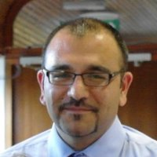
Case Study – UK Experience
Mehran Eskandari Torbaghan
Job Title: Analyst. Project; Highways Agency asset management Atkins
2nd year PhD, wanted “work experiences in my field (Civil Eng) to enhance my workability skills and my business awareness as well as doing some networking for my future career as I want to find a job here in the UK after my graduation.”
Tier4 student visa, permitting 20 hours per week work
Atkins are a registered sponsor and their HR is well aware of visa issues
CV checked by CN and consulted CN during the application process
Top tip: make a plan for your future career based on what you want to do after you study

Slide 17
PG work experience case study
Rebecca Isaacs–Teaching Fellow in US History
Job Titles: Teaching Associate in US History; CV Advisor for Careers
Network; Assistant to Jayne Sharples; PGTA for the UoB Graduate
School; Several others.
Key duties: Teaching second year American History Courses; Offering CV advice; planning, delivering and evaluating Careers Network courses; delivering postgraduate skills courses.
How sourced: Networking; Worklink; JobZone.
Top tips: Meet as many people as you can across the University; Be clear about your goals - what you want to gain from your work experience and where you hope it will lead; identify opportunities or, where they don’t exist, make your own; Be prepared and be proactive.

